Slide 1
5 The Network Layer

Slide 2
Highlights
Network Layer Design Issues
Routing Algorithms
Congestion Control Algorithms
Internetworking
IP

Slide 3
Network Layer
Network Layer Design Issues
Issues 
Datagram 
Virtual Circuit 
Routing Algorithms
Shortest Path Routing 
Flooding 
Distance Vector Routing 
Link State Routing 
Hierarchical Routing 
Congestion Control Algorithms
General Principles 
Congestion Prevention 
Congestion Control 
Load Shedding
Quality of Service
Internetworking
Network Layer in the Internet
Internet's Network Layer 
IPv4 Header 
ICMP 
IP Addresses & Routing Table 
NAT
ARP,DHCP
OSPF
BGP 
IPv6
HomeWork (1) (2)

Slide 4
Overview
Network layer is the lowest layer that deals with end-to-end transmission
Network layer must know about topology
Avoid overloading some of the communication lines and routers while leaving others idle

Slide 5
5.1 Network Layer Design Issues

Slide 6
Issues

Slide 7
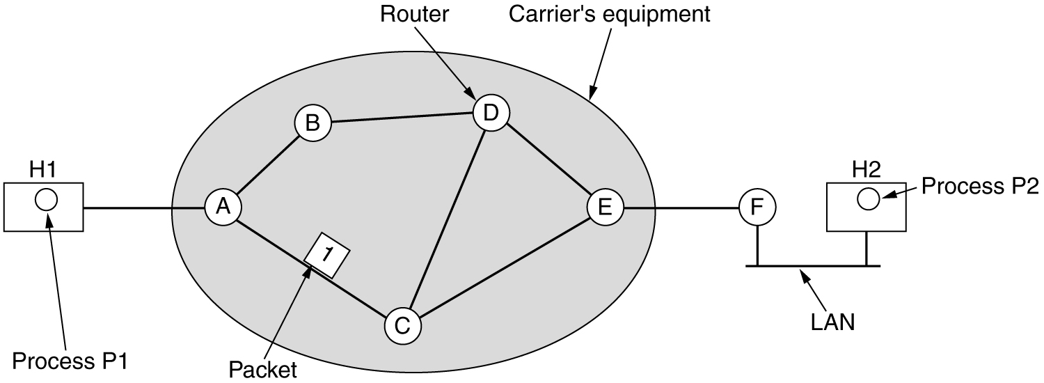
Network Layer Design Issues
Services Provided to Transport Layer
Internal Organization of Network Layer
Store-and-Forward Packet Switching

Slide 8
Services Provided to Transport Layer
Design Goal
The transport layer should be shielded from the number, type, and topology of the routers present
The network addresses made available to the transport layer should use a uniform numbering plan, even across LANs and WANs
Two classes service
Connection-Oriented Service (Virtual Circuit)
Connectionless Service (Datagram)

Slide 9
Datagram

Slide 10
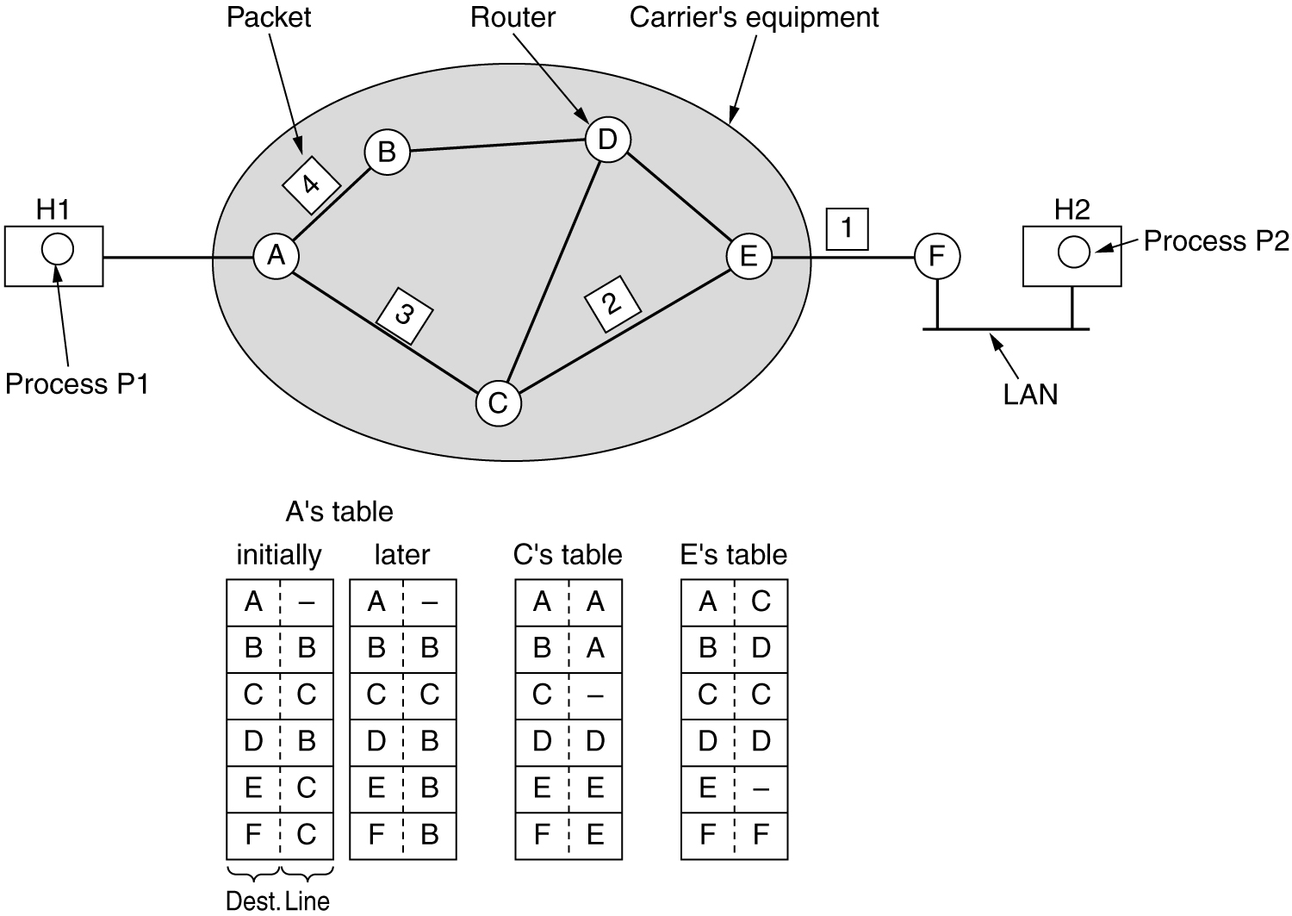
Datagram (1)
Routing within a datagram subnet

Slide 11
Datagram(3)
B.2
B
B.3
B.1
B.3
B.2
B.1
A
C.3
C.2
C.1
C.3
C.1
C
C.2
B.3
B.2
B
2
4
A
1
C.1
B.1
3
5
C.3
C.2
C

Slide 12
Virtual Circuit

Slide 13
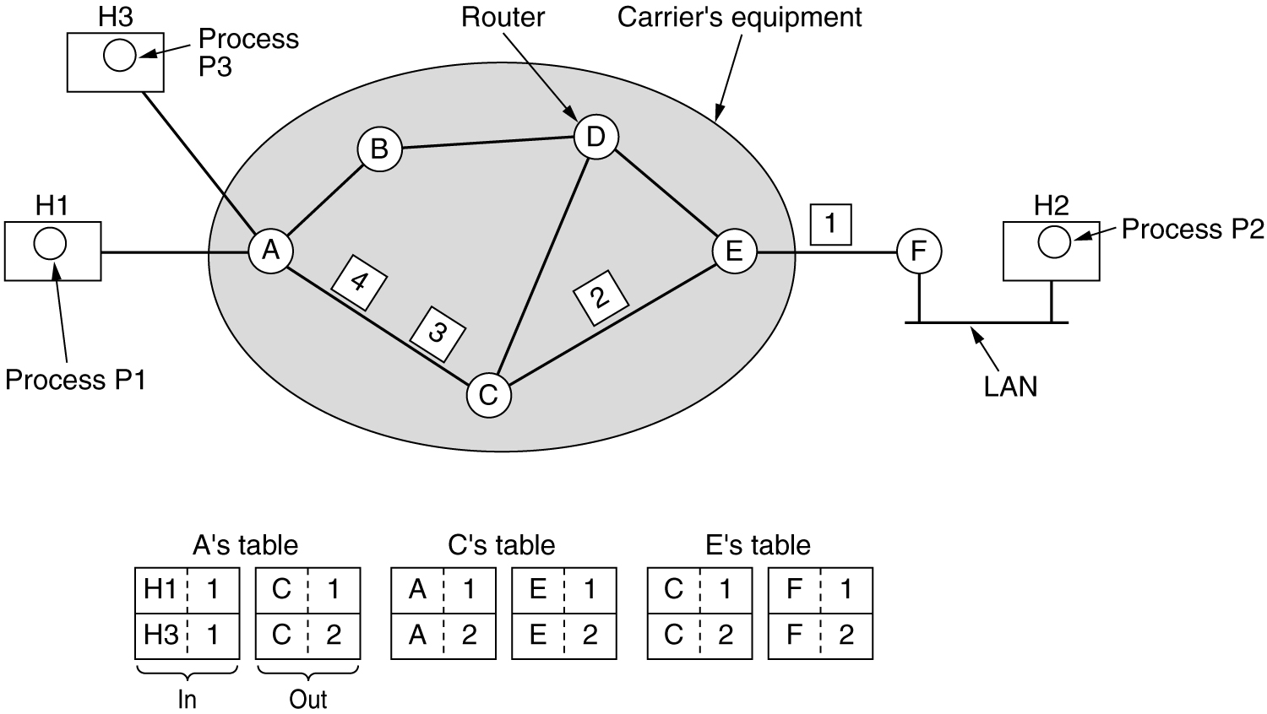
Virtual Circuit (1)
Routing within a virtual-circuit subnet.

Slide 14
Virtual Circuit(2)
B.1
B
B.2
B.3
B.3
B2
B.1
A
C.3
C.2
C.1
C.3
C.2
C
C.1
vc1
B
2
4
vc1: A--1--2--4--B
vc2: A--1--3--5--C
A
1
3
5
vc2
C

Slide 15
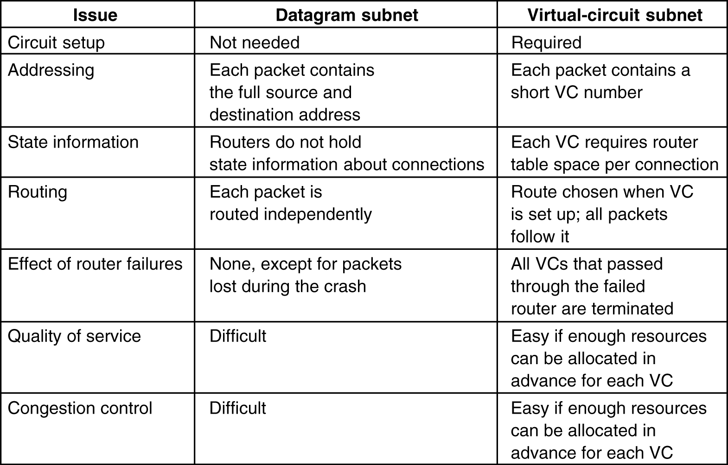
Virtual-Circuit vs. Datagram
5-4

Slide 16
5.2 Routing Algorithms

Slide 17
Responsibility of Routing Algorithms
Responsible for deciding which output line an incoming packet should be transmitted on
If the subnet uses datagrams internally, this decision must be made anew for every arriving data packet since the best route may have changed since last time
If the subnet uses virtual circuits internally, routing decisions are made only when a new virtual circuit is being set up. Thereafter, data packets just follow the previously-established route (Session routing)
Forwarding & Routing

Slide 18
Goals for the Routing Algorithm
Correctness
Simplicity
Robustness
Stability
Fairness
Optimality
Minimizing mean packet delay
Maximizing total network throughput

Slide 19
Classification of Routing Algorithms
Nonadaptive algorithms (Static Routing)
Do not base their routing decisions on measurements or estimates of the current traffic and topology
The choice of the route to use is computed in advance, off-line, and downloaded to the routers when the network is booted
Adaptive algorithms
Change their routing decisions to reflect changes in the topology, and usually the traffic as well

Slide 20
The Optimality Principle
If router J is on the optimal path from router I to router K, then the optimal path from J to K also falls along the same route
If a route r_{x} better than r₂ existed from J to K, it could be concatenated with r₁ to improve the route from I to K
Contradicting our statement that r₁r₂ is optimal
I
r₁
J
r_{x}
r₁+r₂
？
r₁+r_{x}
r₂
K

Slide 21
Sink Tree
Optimal routes from all sources to a destination form a tree rooted at the destination
Does not contain any loops, so each packet will be delivered within a finite number of hops
The goal of routing algorithms
Discover and use the sink trees for all routers
Different routers may have different ideas about the current topology sometime

Slide 22
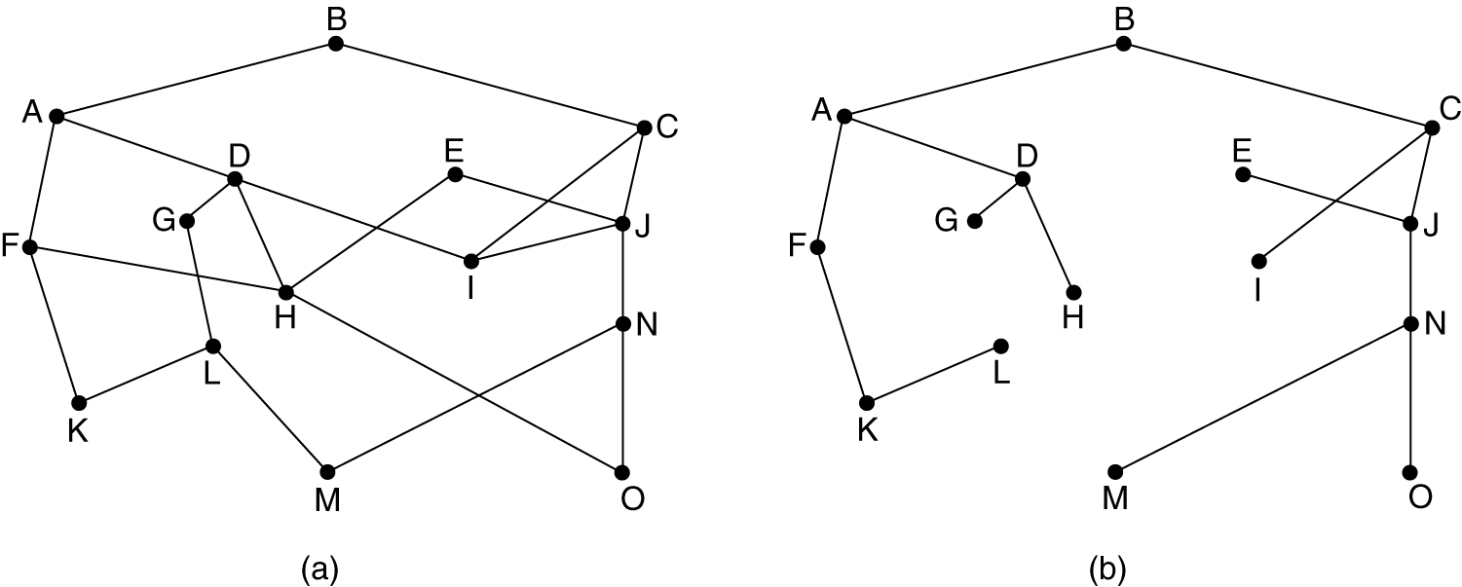
Example of Sink Tree
(a) A subnet. (b) A sink tree for router B

Slide 23
Shortest Path Routing

Slide 24
Shortest Path Routing
Build a weighted and directed graph of subnet
Nodes represent routers
Arcs represents communication lines
Weight
Hops
Geographic distance in kilometers
Mean queueing and transmission delay
Determined by hourly test, some standard test packet
A function of the distance, bandwidth, average traffic, communication cost, mean queue length, measured delay, and other factors
Dijkstra Algorithm
Finds the shortest path between a given pair of routers

Slide 25
Flooding

Slide 26
Flooding
No network info required
Incoming packets retransmitted on every link except incoming link
Eventually a number of copies will arrive at destination
2
3
6
1
4
5

Slide 27
Techniques for Damping the Flood
Problem
Generates vast numbers of duplicate packets
an infinite number unless some measures are taken to damp the process
Measures
The header of each packet contains a hop counter
Counter is decremented at each hop
When the counter reaches zero, discard the packet
Sender initializes the hop counter as the length of the path from source to destination, or the subnet diameter
Source puts a sequence number in each packet
Each router records maximal seq per source telling which seq have already been seen
Selective flooding
Each router records received data items in database
Every data items contains a version number
Olny new data items will be flooded

Slide 28
Properties of Flooding
All possible routes are tried
Very robust
At least one packet will have taken minimum hop count route
All nodes are visited
Useful to distribute routing information

Slide 29
Distance Vector Routing

Slide 30
Distance Vector Routing
Each router maintains a table
The best known distance to each destination
The distance might be number of hops, time delay in milliseconds, …
Which line to use
The table is updated by exchanging information with neighbors
Send Routing information (Destination, Distance)
Periodically (RIP Routing Information Protocol:30 seconds)
Whenever table changes (triggered update)
Receive Routing information
Update local table if receive a better route
Refresh existing routes
Delete routing table items if they time out (RIP 180s)

Slide 31
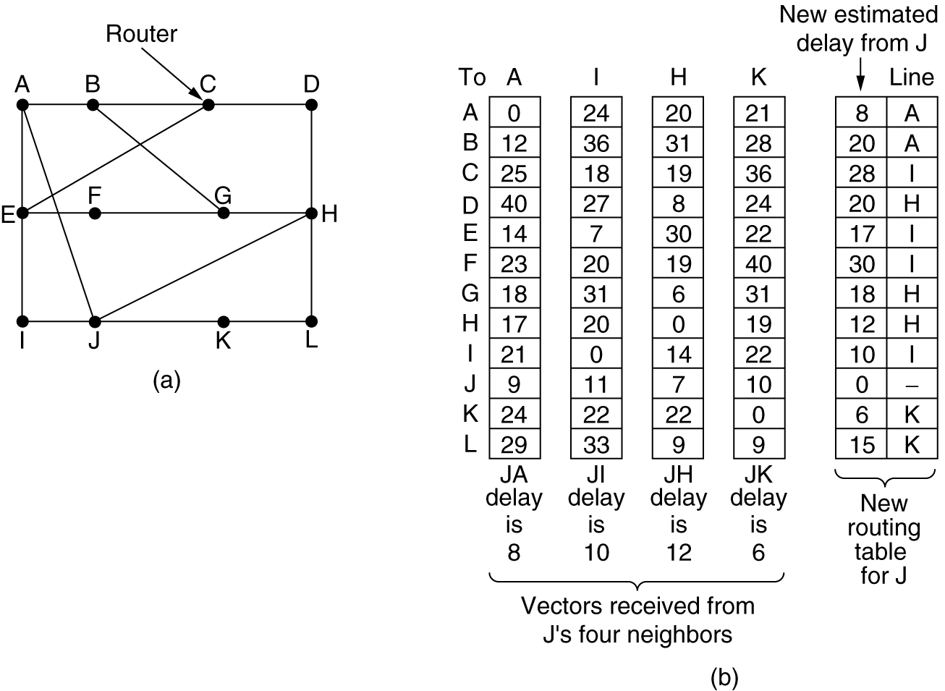
Example 1
Input from A, I, H, K, and the new routing table for J.

Slide 32
Example 2: Initial Status
Node A
Node B
Dest. | Cost | NextHop
B | 2 | B
C | 7 | C
D | ∞ | -
Dest. | Cost | NextHop
A | 2 | A
C | 1 | C
D | 3 | D
B
3
D
2
1
A
C
1
7
Node C
Node D
Dest. | Cost | NextHop
A | 7 | A
B | 1 | B
D | 1 | D
Dest. | Cost | NextHop
A | ∞ | -
B | 3 | B
C | 1 | C

Slide 33
Example 2: 1st Iteration (C → A)
Node A
Node B
Dest. | Cost | NextHop
B | 2 | B
C | 7 | C
D | 8 | C
Dest. | Cost | NextHop
A | 2 | A
C | 1 | C
D | 3 | D
B
3
D
2
1
A
C
1
7
D(A, D) = D(A, C) + D(C,D) = 7 + 1 = 8
(D(C,A), D(C,B), D(C,D))
Node C
Node D
Dest. | Cost | NextHop
A | 7 | A
B | 1 | B
D | 1 | D
Dest. | Cost | NextHop
A | ∞ | -
B | 3 | B
C | 1 | C

Slide 34
Example 2: 1st Iteration (B→A, C→A)
Node A
Node B
Dest. | Cost | NextHop
B | 2 | B
C | 3 | B
D | 5 | B
Dest. | Cost | NextHop
A | 2 | A
C | 1 | C
D | 3 | D
B
3
D
2
1
A
C
1
7
D(A,D) = D(A,B) + D(B,D) = 2 + 3 = 5
D(A,C) = D(A,B) + D(B,C) = 2 + 1 = 3
Node C
Node D
Dest. | Cost | NextHop
A | 7 | A
B | 1 | B
D | 1 | D
Dest. | Cost | NextHop
A | ∞ | -
B | 3 | B
C | 1 | C

Slide 35
Example 2: End of 1st Iteration
Node A
Node B
Dest. | Cost | NextHop
B | 2 | B
C | 3 | B
D | 5 | B
Dest. | Cost | NextHop
A | 2 | A
C | 1 | C
D | 2 | C
B
3
D
2
1
A
C
1
7
Node C
Node D
Dest. | Cost | NextHop
A | 3 | B
B | 1 | B
D | 1 | D
Dest. | Cost | NextHop
A | 5 | B
B | 2 | C
C | 1 | C

Slide 36
Example 2: End of 2nd Iteration
Node A
Node B
Dest. | Cost | NextHop
B | 2 | B
C | 3 | B
D | 4 | B
Dest. | Cost | NextHop
A | 2 | A
C | 1 | C
D | 2 | C
B
3
D
2
1
A
C
1
7
Node C
Node D
Dest. | Cost | NextHop
A | 3 | B
B | 1 | B
D | 1 | D
Dest. | Cost | NextHop
A | 4 | C
B | 2 | C
C | 1 | C

Slide 37
Example 2: End of 3rd Iteration
Node A
Node B
Dest. | Cost | NextHop
B | 2 | B
C | 3 | B
D | 4 | B
Dest. | Cost | NextHop
A | 2 | A
C | 1 | C
D | 2 | C
B
3
D
2
1
A
C
1
7
Node C
Node D
Dest. | Cost | NextHop
A | 3 | B
B | 1 | B
D | 1 | D
Dest. | Cost | NextHop
A | 4 | C
B | 2 | C
C | 1 | C
Nothing changes → algorithm terminates

Slide 38
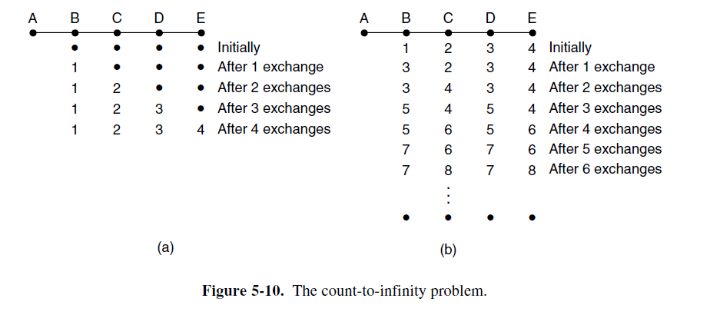
Count-to-infinity Problem

Slide 39
Count-to-infinity Problem
“bad news travels slowly”
cost(B,A)= ∞
A
D
1
Another problem:
cost(B,A): changed 1 to 4
cost(B,A): changed 4 to 1
B
C
1
1
D | C | N
A | 1 | A
C | 1 | C
D | 2 | C
D | C | N
A | ∞ | -
C | 1 | C
D | 2 | C
D | C | N
A | 3 | C
C | 1 | C
D | 2 | C
D | C | N
A | 3 | C
C | 1 | C
D | 2 | C
D | C | N
A | 5 | C
C | 1 | C
D | 2 | C
D | C | N
A | 5 | C
C | 1 | C
D | 2 | C
D | C | N
A | 7 | C
C | 1 | C
D | 2 | C
B
D | C | N
A | 2 | B
B | 1 | B
D | 1 | D
D | C | N
A | 2 | B
B | 1 | B
D | 1 | D
D | C | N
A | 2 | B
B | 1 | B
D | 1 | D
D | C | N
A | 4 | B
B | 1 | B
D | 1 | D
D | C | N
A | 4 | B
B | 1 | B
D | 1 | D
D | C | N
A | 6 | B
B | 1 | B
D | 1 | D
D | C | N
A | 6 | B
B | 1 | B
D | 1 | D
…
C
RIP: Set infinity to 16
D | C | N
A | 3 | C
B | 2 | C
C | 1 | C
D | C | N
A | 3 | C
B | 2 | C
C | 1 | C
D | C | N
A | 3 | C
B | 2 | C
C | 1 | C
D | C | N
A | 3 | C
B | 2 | C
C | 1 | C
D | C | N
A | 5 | C
B | 2 | C
C | 1 | C
D | C | N
A | 5 | C
B | 2 | C
C | 1 | C
D | C | N
A | 7 | C
B | 2 | C
C | 1 | C
D
time

Slide 40
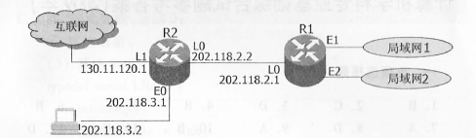
Example

Slide 41
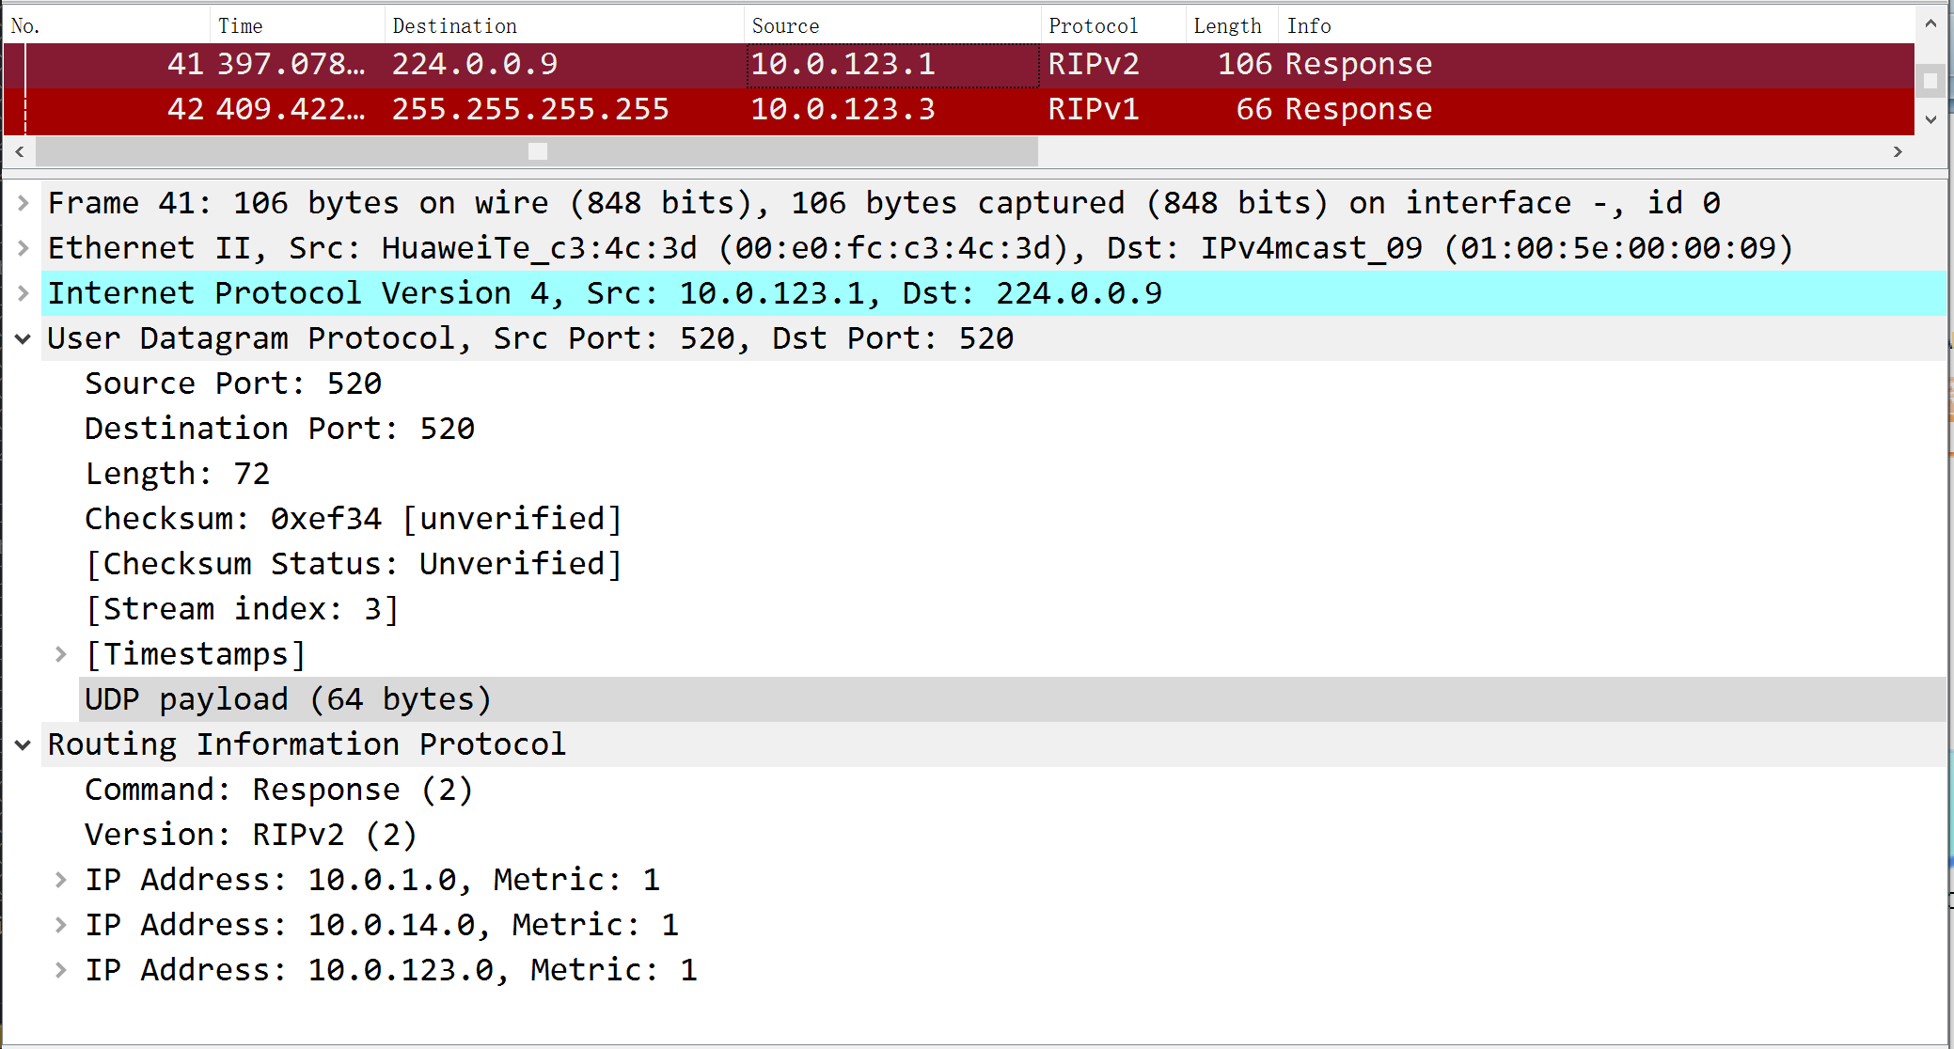
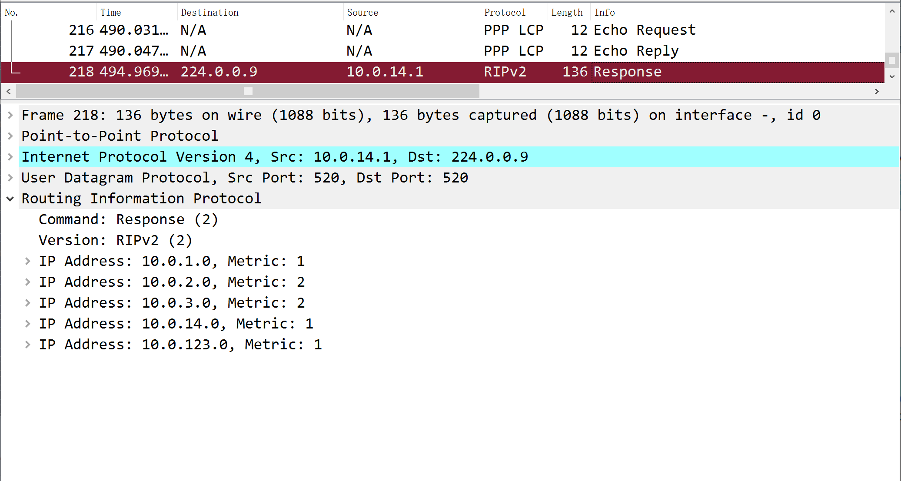
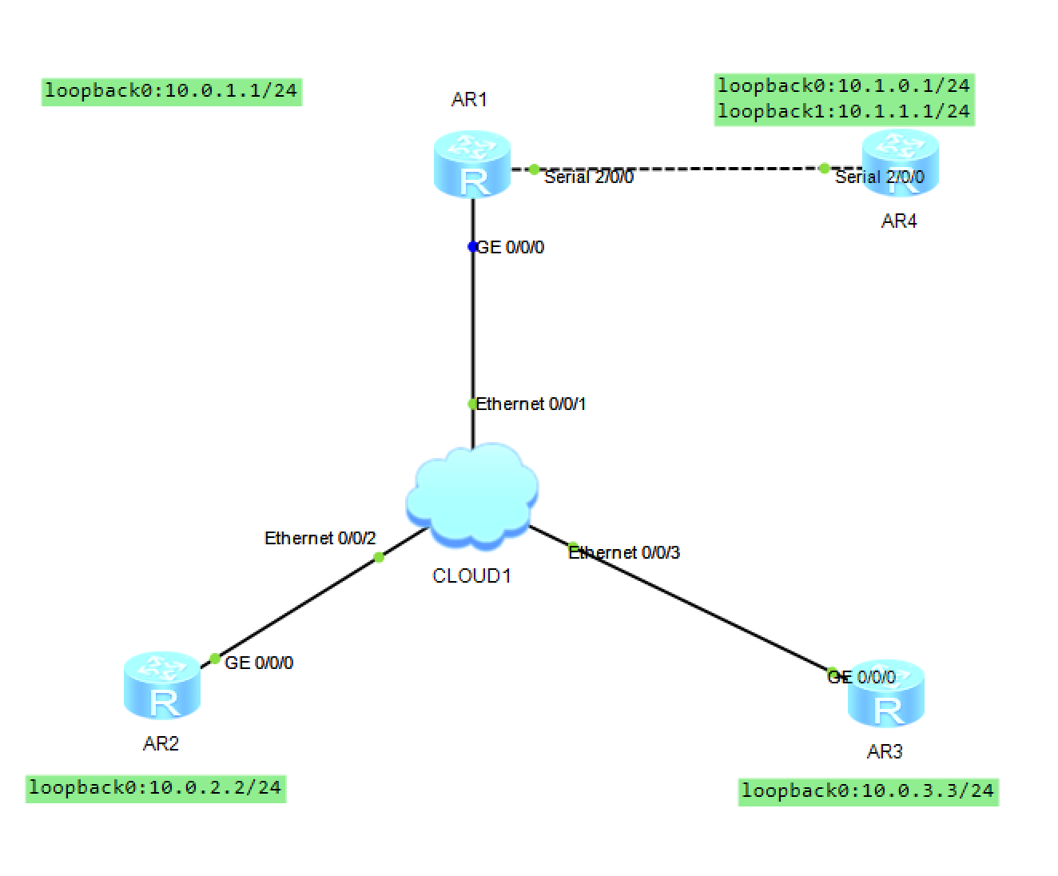
Example

Slide 42
Problem of Distance Vector Routing
Distance Vector Routing
RIP (Routing Information Protocol)
Cisco EIGRP (Enhanced Interior Gateway Routing Protocol)
The problem of Distance Vector algorithm
When X tells Y that it has a path somewhere, Y has no way of knowing whether it itself is on the path
Routed by rumor
Path Vector Routing
BGP-4 (Border Gateway Protocol)
IDRP (Inter-domain Routing Protocol)

Slide 43
Link State Routing

Slide 44
Link State Routing
Each router must do the following
1. Discover its neighbors, learn their network address
2. Set the distance or cost metric to each of its neighbors.（Measure the delay or cost to each of its neighbors）
3. Construct a packet (LSP: Link-state Packet) telling all it has just learned
4. Send LSP to all other routers (not only neighbors) reliably
5. Compute the shortest path to every other router

Slide 45
1. Learning about the Neighbors
HELLO packet
Broadcast network: Broadcast a special HELLO packet
Multi-access network: Unicast HELLO to neighbors
Neighbors send back a reply telling who it is
Names (Route IDs) must be globally unique
Simplify the topology
When two or more routers are connected by a LAN or other multi-access network

Slide 46
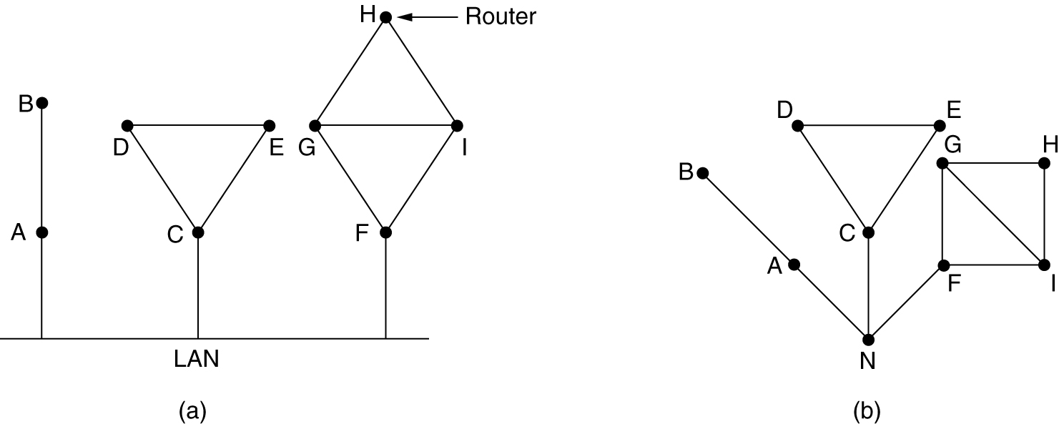
Artificial Node
(a) Nine routers and a LAN. (b) A graph model of (a)

Slide 47
2. Setting Link Costs
The cost to each of its neighbors
The cost to reach neighbors can be set automatically
Configured by the network operator
Make the cost inversely proportional to the bandwidth of the link

Slide 48
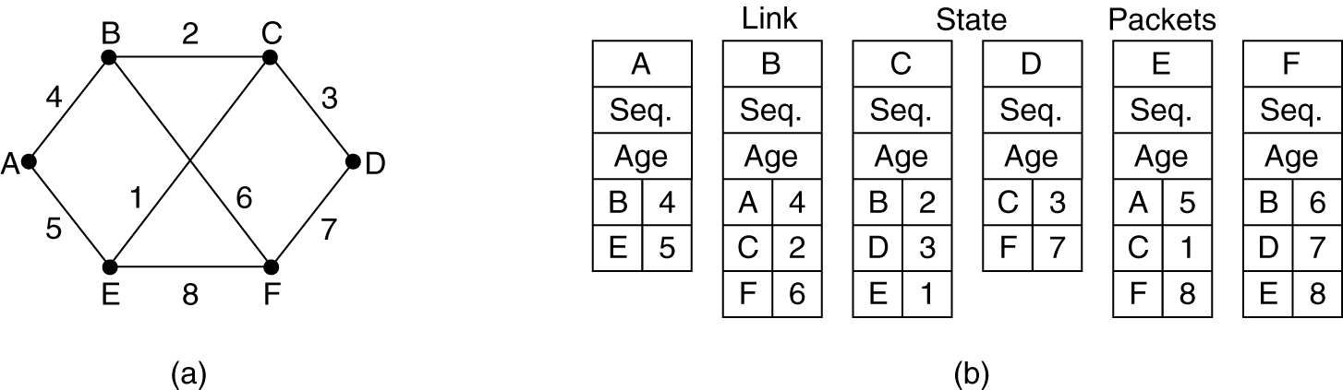
3. Building Link State Packets
(a) A subnet. (b) The link state packets for this subnet
When to build LSP
Build LSP periodically
Build LSP when some significant event occurs
such as a line or neighbor going down or coming back up again or changing its properties appreciably

Slide 49
4. Distributing the Link State Packets
Responsibility
Distributing the LSP reliably
Avoid different routers from using different versions of the topology, which can lead to inconsistencies, loops, unreachable machines, and other problems
The basic distribution algorithm
Use flooding to distribute LSPs
Guard against errors on the router-router lines, all LSP are acknowledged

Slide 50
About Link State Packets
Sequence number
If LSP is new, forwarded it on all lines except the one it arrived on
If LSP is a duplicate, it is discarded (selective flooding)
If lower than the highest one seen so far ever arrives, it is rejected as being obsolete
If a router is down, and then restart, rejected
if the sequence numbers wrap around, 32bit sequence number
if a sequence number is ever corrupted, …
Age
If a router is down
If a router changed its routerID

Slide 51
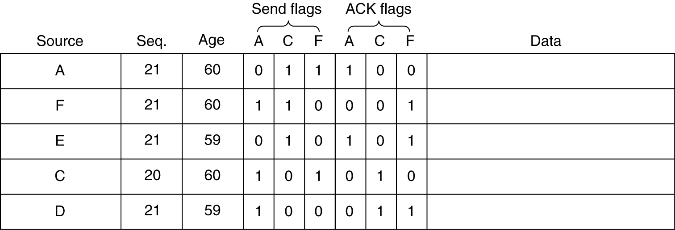

Refinements to LSP Flooding Algorithm

Slide 52
5. Computing the New Route
Once a router has accumulated a full set of LSPs, it can construct the entire graph
Every link is represented twice, once for each direction. The two values can be averaged or used separately
Run Dijkstra's algorithm locally to construct the shortest path to all possible destinations
The results of this algorithm can be installed in the routing tables

Slide 53
广域网
W₄
广域网
W₁
广域网
W₆
5
12
10
E
B
D
7
A
4
8
广域网
W₂
H
I
4
2
3
8
13
局域网
L₁
2
F
G
16
3
3
2
C
12
广域网
W₅
6
局域网
L₂
广域网
W₃
(a) 网络拓扑
W₄
W₁
B
4
D
12
10
E
H
W₆
5
7
8
W₂
A
2
4
8
7
3
13
3
4
8
3
I
F
L₁
G
2
12
L₂
2
W₅
6
16
C
W₃
(b) 有向图

Slide 54
W₄
W₁
有向图
B
4
D
12
10
E
H
W₆
5
7
8
W₂
A
4
8
7
2
3
13
3
4
8
3
I
F
L₁
G
2
12
L₂
2
W₅
6
16
C
Dest | NextHop
L1 | D
L2 | G
W1 | D
W2 | D
W3 | (direct)
W4 | D
W5 | (direct)
W6 | G
F
的
路
由
表
W₃
以路由器F为根的最短路径树
W₁
W₄
12
B
D
E
W₂
W₆
5
4
7
8
A
3
8
4
F
L₂
I
G
3
L₁
6
16
W₅
W₃

Slide 55
Examples of Link State Routing
IS-IS (Intermediate System-Intermediate System)
DECnet
ISO CLNP
IP
AppleTalk
Novell NLSP (IPX)
support multiple network layer protocols at the same time
OSPF (Open Shortest Path First)
designed several years after IS-IS
Only for IP

Slide 56
Hierarchical Routing

Slide 57
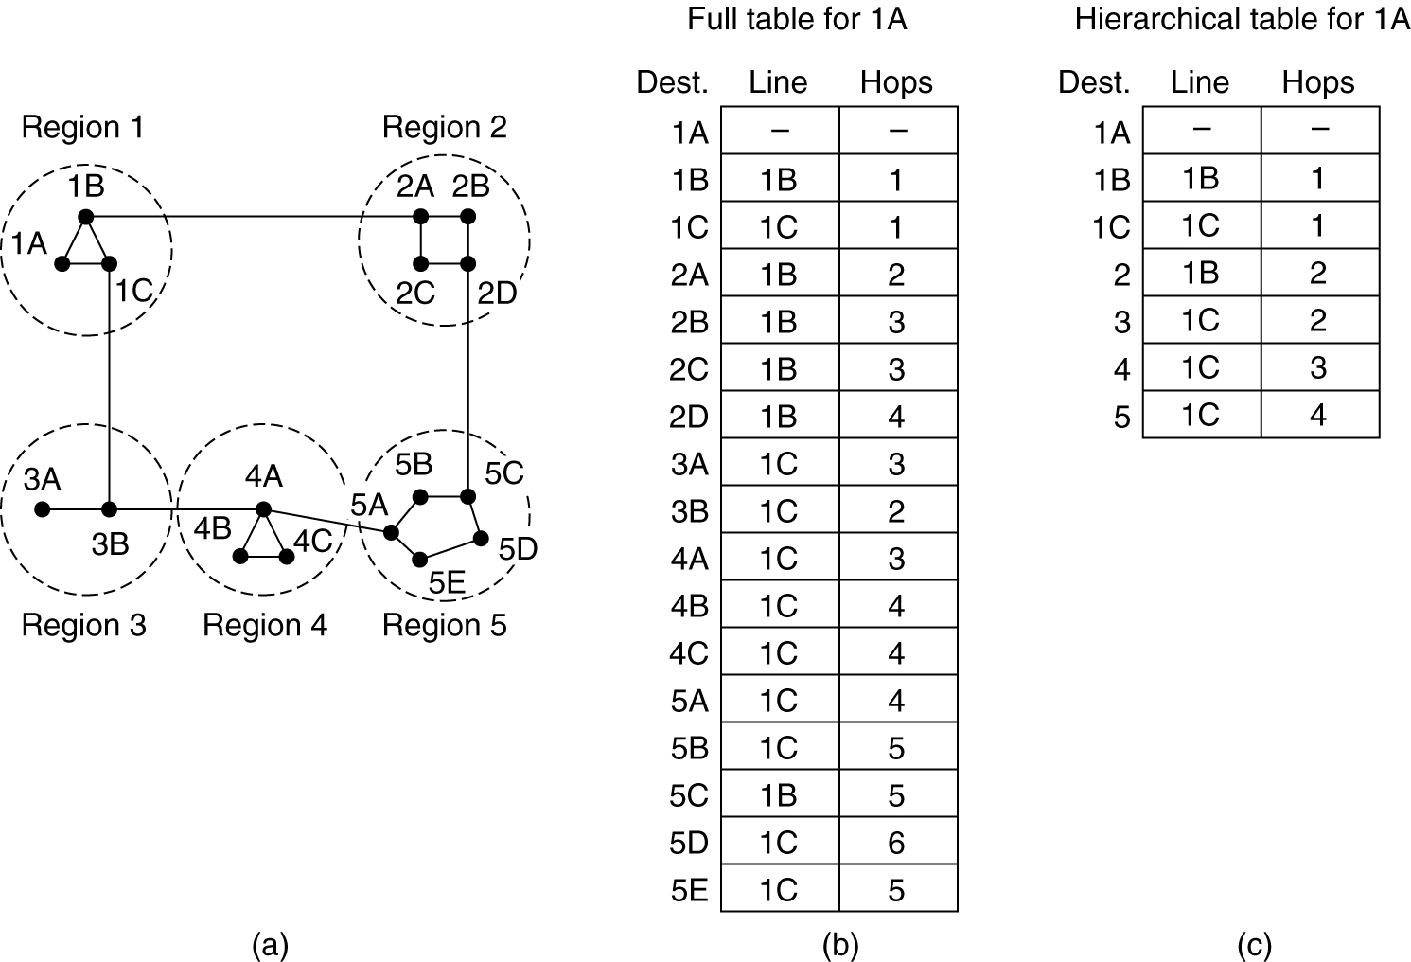
Hierarchical Routing (1)

Slide 58
Hierarchical Routing (2)
Consider a subnet with 720 routers.
If there is no hierarchy
720 routing table entries
If the subnet is partitioned into 24 regions of 30 routers each (Total:53)
30 local entries
23 remote entries
If a three-level hierarchy is chosen, with 8 clusters, each containing 9 regions of 10 routers (Total: 25)
10 entries for local routers
8 entries for routing to other regions within its own cluster
7 entries for distant clusters

Slide 59
5.3 Congestion Control Algorithms

Slide 60
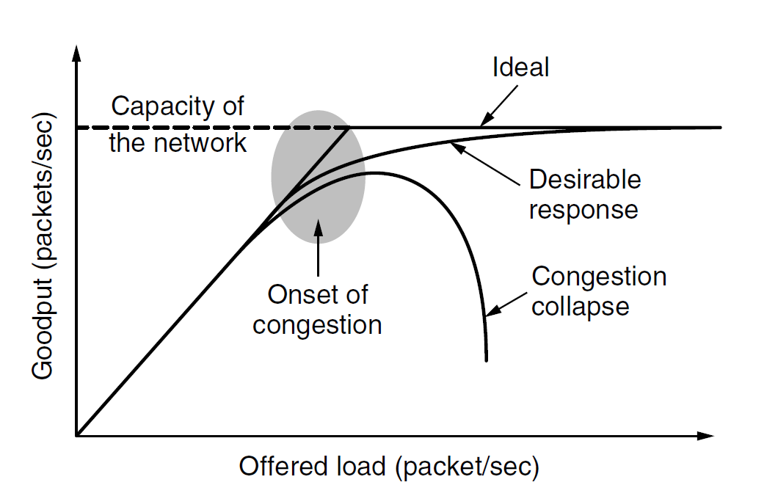
Congestion
When too much traffic is offered, congestion sets in and performance degrades sharply
次要因素：突发流量与缓冲队列(太长/太短)
慢CPU忙于维护操作，转发操作太慢导致线路容量浪费

Slide 61
Congestion Control & Flow Control
The difference between congestion control and flow control
Congestion control is a global issue
Flow control is to make sure that a fast sender cannot continually transmit data faster than the receiver is able to absorb it

Slide 62
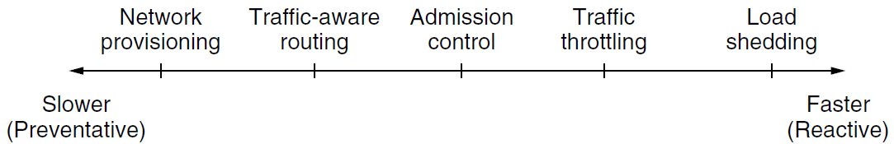
Approaches to Congestion Control
Network Provisioning
Traffic-aware routing
Admission Control
Traffic throtting
Load shedding

Slide 63
Traffic-aware Routing
The normal routing schemes
Used fixed link weights，adapted to changes in topology, but not to changes in load
Traffic-aware Routing
Set the link weight to be a function of the link bandwidth and propagation delay plus the measured load or average queuing delay
Danger： routing tables may oscillate wildly, leading to erratic routing and many potential problems
If load is ignored and only bandwidth and propagation delay are considered, this problem does not occur
In the Internet routing protocols do not generally adjust their routes depending on the load

Slide 64
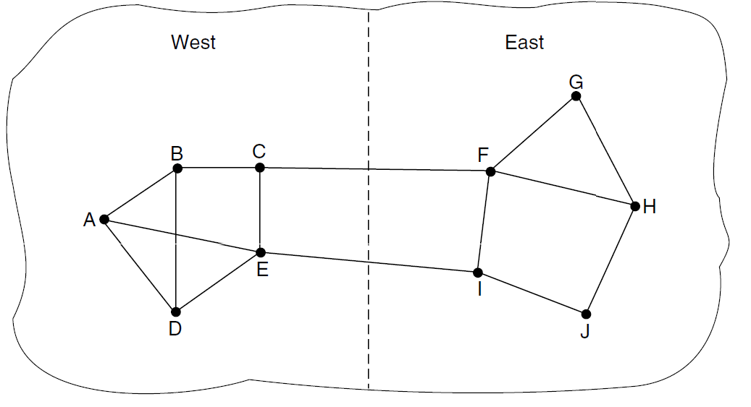
Traffic-aware Routing

Slide 65
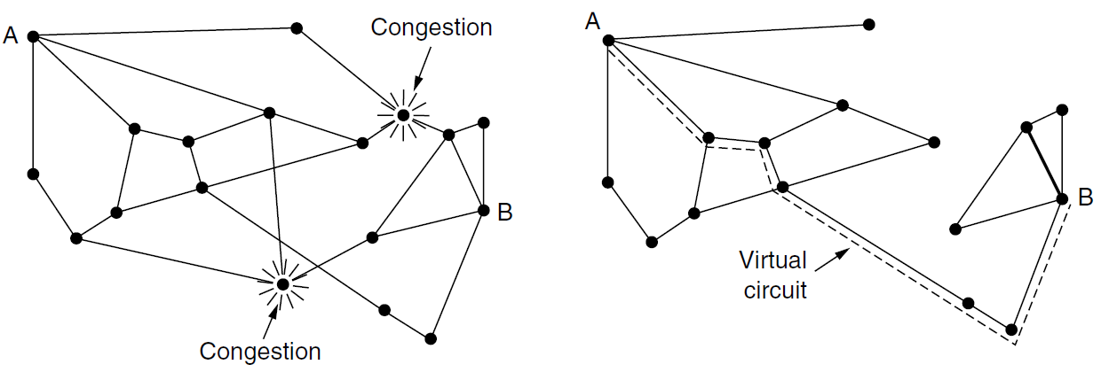
Admission Control
Widely used in virtual-circuit networks
Do not set up a new virtual circuit unless the network can carry the added traffic without becoming congested
Traffic descriptions: described in terms of its rate and shape (leaky bucket or token bucket)
Can also be combined with traffic-aware routing by considering routes around traffic hotspots as part of the setup procedure

Slide 66
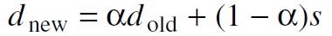
Traffic Throttling (1)
When congestion is imminent, the net must tell the senders to throttle back their transmissions and slow down
Routers must determine when congestion is approaching, ideally before it has arrived
the utilization of the output links
the buffering of queued packets inside the router
the number of packets that are lost
平均值计算方法
EWMA (Exponentially Weighted Moving Average)
Routers must deliver timely feedback to the senders that are causing the congestion
Choke packets
ECN
Hop-by-Hop backpressure

Slide 67
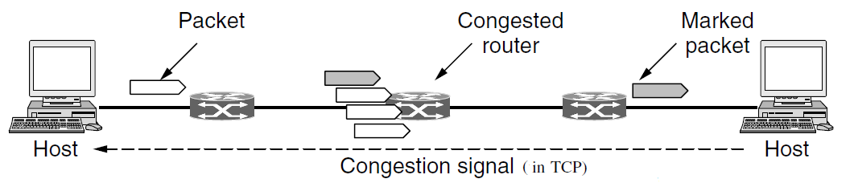
Traffic Throttling (2)
Choke Packets
router selects a congested packet and sends a choke packet back to the source, giving it the destination found in the packet
（Internet SOURCE QUENCH message）
ECN(Explicit Congestion Notification)
Router can tag any packet it forwards (by setting a bit in header) to signal that it is experiencing congestion
When the net delivers the packet, the destination can note the congestion and inform the sender when it sends a reply packet
The sender can then throttle its transmissions as before
(Two bits in IP header are used to record whether the packet has experienced congestion)

Slide 68
Traffic Throttling (3)
Hop-by-Hop Choke Packets
Problem of sending a choke packet to the source
High speed
Over long distance
Have the choke packet take effect at every hop it passes through
Provide quick relief at the point of congestion at the price of using up more buffers upstream

Slide 69
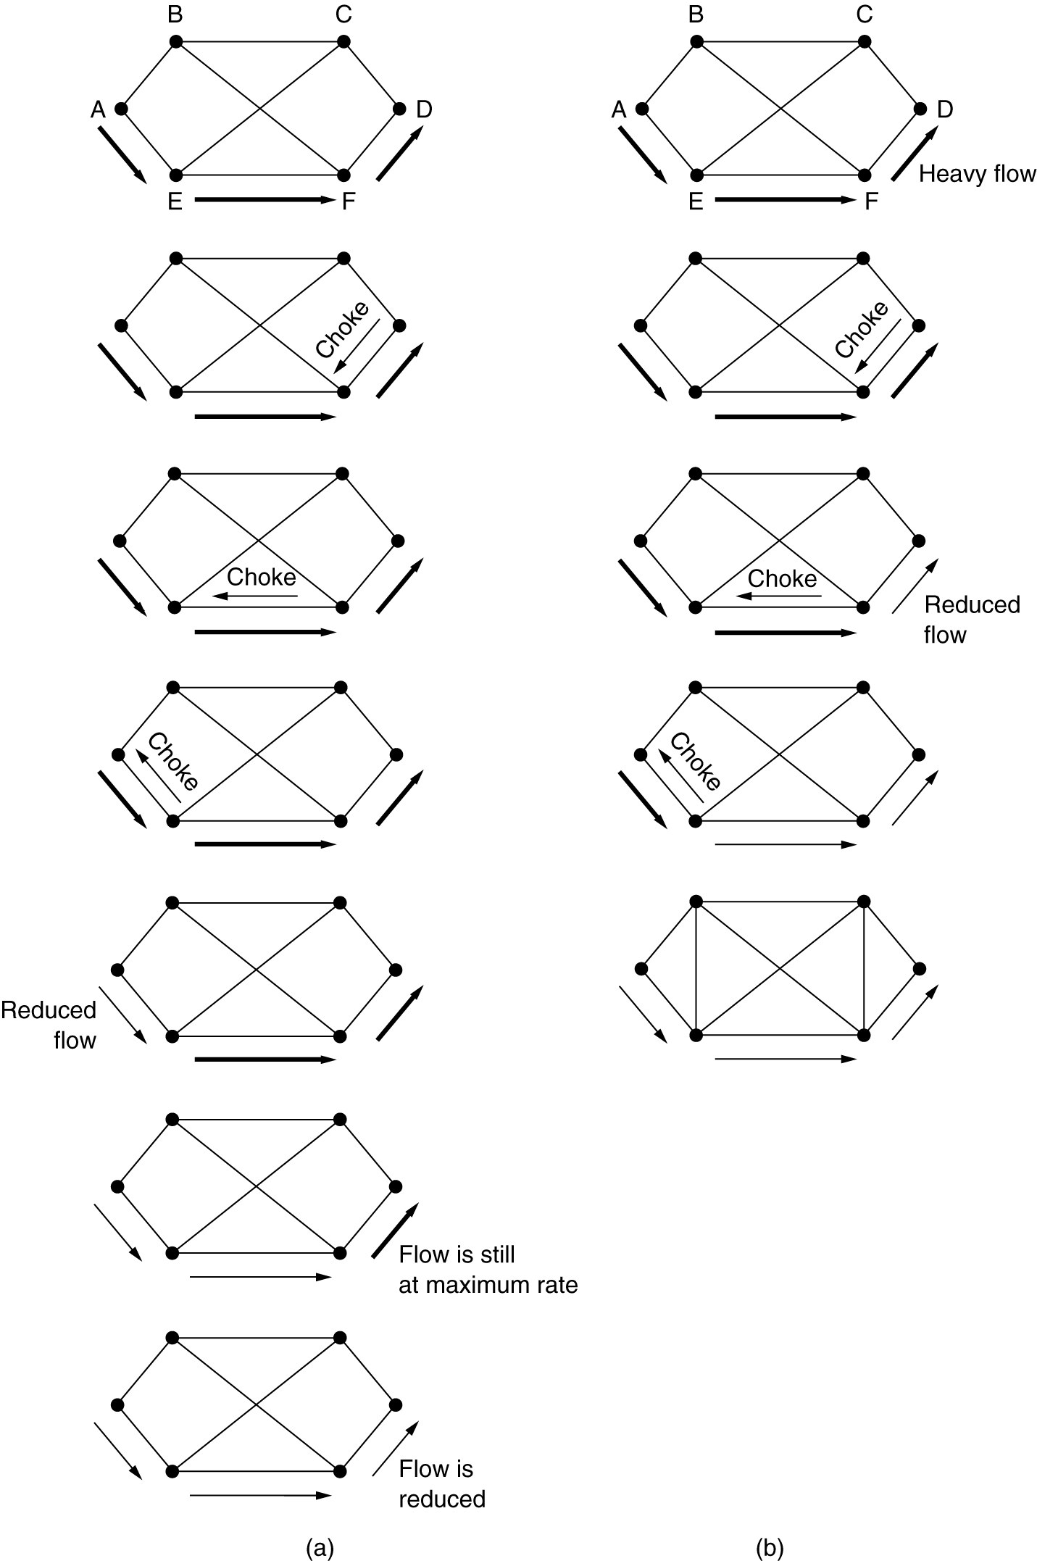
Hop-by-Hop Choke Packets
(a) A choke packet that affects only the source
(b) A choke packet that affects each hop it passes through

Slide 70
Loading Shedding (1)
Loading Shedding
When routers are being inundated by packets, just throw them away
Policies
Wine & Milk
E.g. file transfer, multimedia
Requires cooperation from the senders
Packet priority
E.g. algorithms for compressing video, …
The low-priority packets being cheaper to send than the high-priority ones, …
Allow hosts to exceed the limits specified in agreement, but all excess traffic must be marked as low priority

Slide 71
Loading Shedding (2)
RED (Random Early Detection)
Drop packets before situation becomes hopeless
When the average queue length on some line exceeds a threshold (be congested), action is taken
How should router tell source about the problem?
Send a choke packet
Just discard the selected packet
Sources respond to lost packets by slowing down their transmission rate
Only works when sources respond to lost packets by slowing down their transmission rate
ECN & RED
RED routers improve performance compared to routers that drop packets only when buffers are full
ECN is the preferred option, it delivers a congestion signal explicitly rather than as a loss; RED is used when hosts cannot receive explicit signals

Slide 72
5.4 Quality of Service

Slide 73
Four Primary Parameters
Reliability
Delay
Jitter
Bandwidth

Slide 74
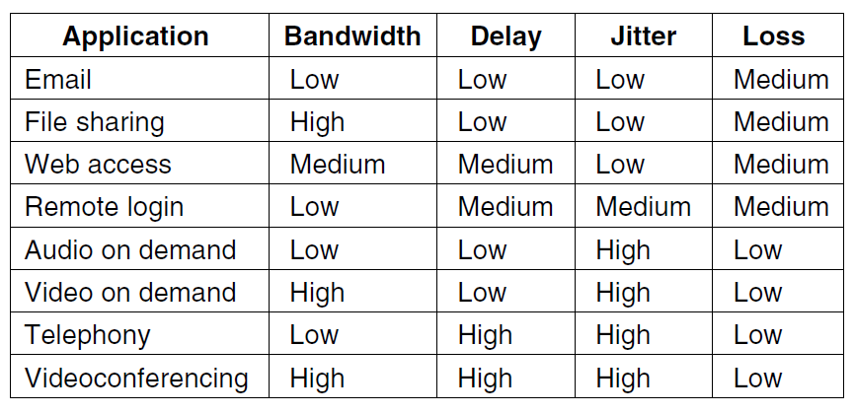
Requirements
5-30

Slide 75
Traffic Shaping
Problem
Host emits the packets irregularly, which may cause congestion to occur in network
Service Level Agreement (SLA)
Between the user and the subnet
The user: traffic shaping reduces congestion and helps carrier live up to its promise
The carrier: traffic policing
(CAR: Committed Access Rate)
Traffic shaping
Regulate the average rate and burstiness of data transmission, smooth out the traffic
Traffic Policing
Monitoring a traffic flow
Packets in excess of the agreed pattern might be dropped or marked as having lower priority

Slide 76
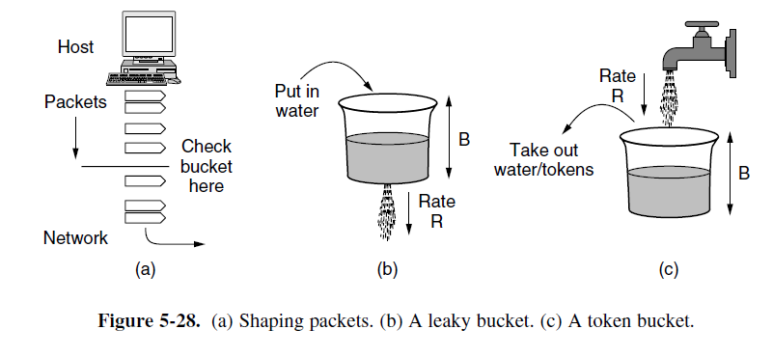
The Bucket Algorithm

Slide 77
The Leaky Bucket Algorithm
Turns an uneven flow of packets into an even flow
Smoothing out bursts
Reducing the chances of congestion
Bucket can be used to shape or police packets entering the network
If a packet arrives when the bucket is full， the packet must be queued until enough water leaks out to hold it （host shapes its traffic) or be discarded (network polices traffic)

Slide 78
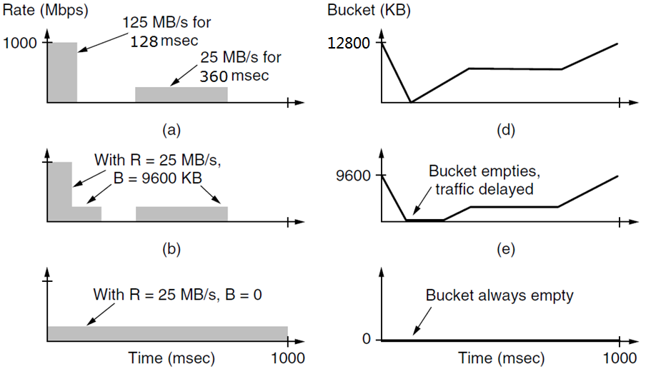
The Token Bucket Algorithm
Notes:
125*128/1000=16M 25*360/1000=9M
125*96/1000=12M,25*160=4M
25*1000/1000=25M

Slide 79
Length of Maximum Rate Burst
burst length S sec
token bucket capacity B bytes
token arrival rate R bytes/sec
maximum output rate M bytes/sec
B + RS = MS
S = B/(M - R )
B=9600KB, M = 125 MB/s, R=25 MB/s
S=9600/(125 – 25)=96 ms
*突发速率为10Mbps的一台主机通过一个令牌桶进行流量调整。令牌桶的令牌到达速率为2Mbps，令牌桶的初始容量为8Mb。请问该主机以10Mbps速率可以传输多长时间？

Slide 80
Packet Scheduling
Resources can be reserved for different flows
Bandwidth
Buffer space
CPU cycles
Algorithms
FIFO (FCFS), tail drop
RED Algorithm
Fair queueing algorithm

Slide 81
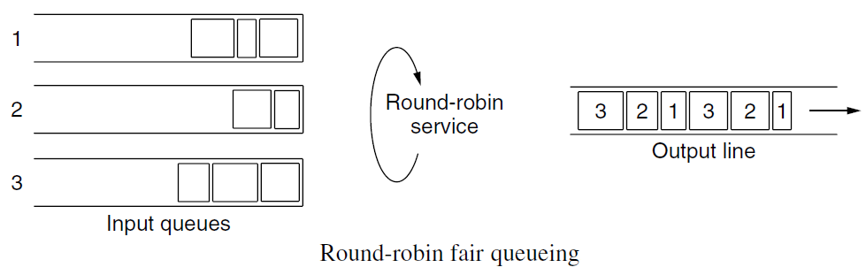
Round-robin Fair Queueing
Problem
It gives more bandwidth to hosts that use large packets than to hosts that use small packets

Slide 82
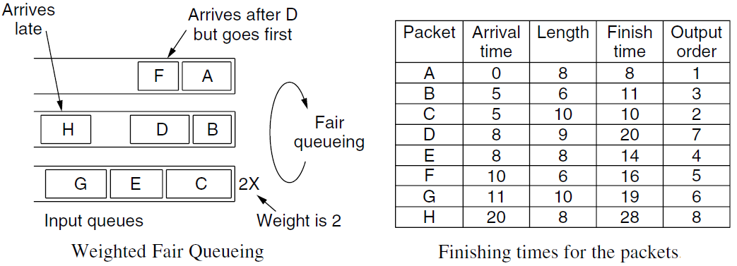
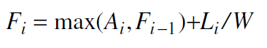
WFQ: Weighted Fair Queueing
A_{i}: arrival time, F_{i}: finish time, L_{i}: length of packet i
W: weight of the flow
Implementation complexity
With N flows: O(logN) per packet

Slide 83
5.5 Internetworking

Slide 84
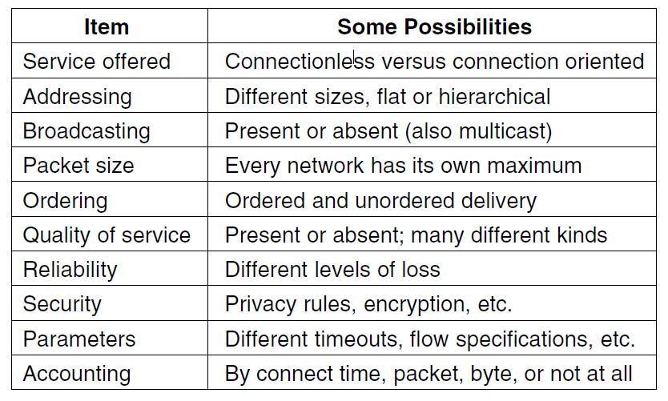
How Networks Differ

Slide 85
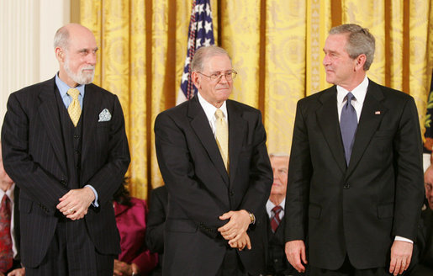
Connecting Different Networks
Two basic choices
Build devices that translate or convert packets from each kind of network into packets
Add a layer of indirection and building a common layer on top of the different networks (Cerf and Kahn, 1974)

Slide 86
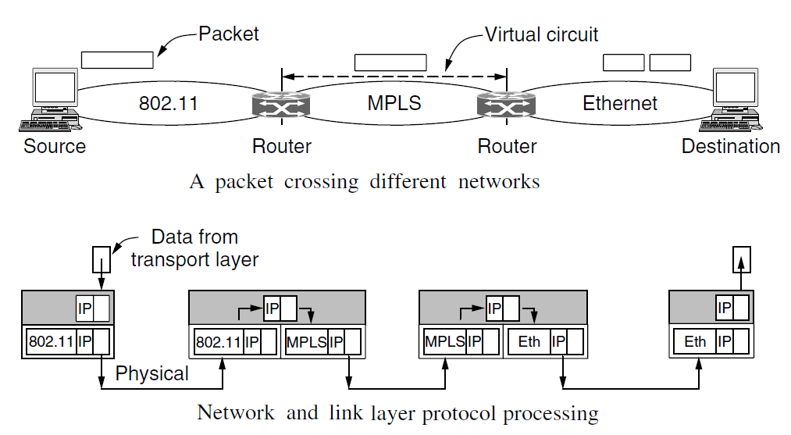
How Networks Can Be Connected

Slide 87
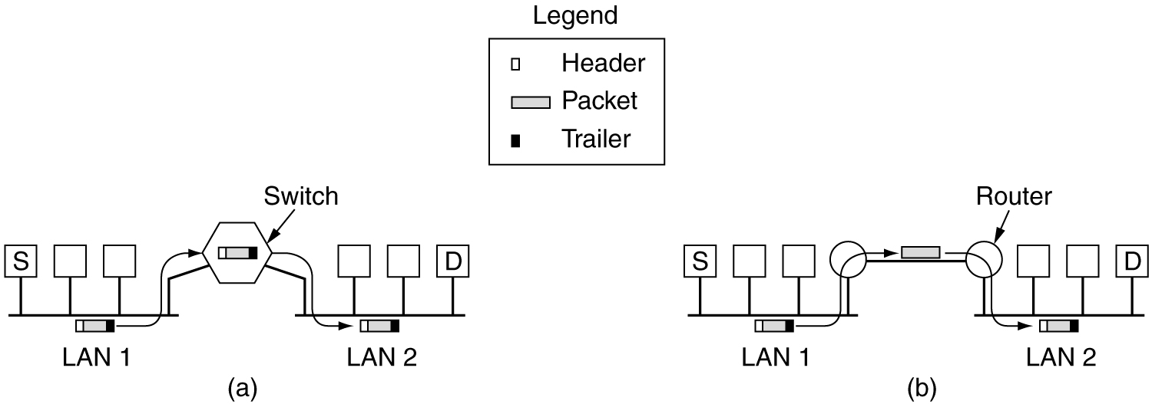
Bridge & Router
Bridge: the entire frame is transported on the basis of its MAC address
Router: packet is extracted from the frame and the Layer-3 address is used for deciding where to send it

Slide 88
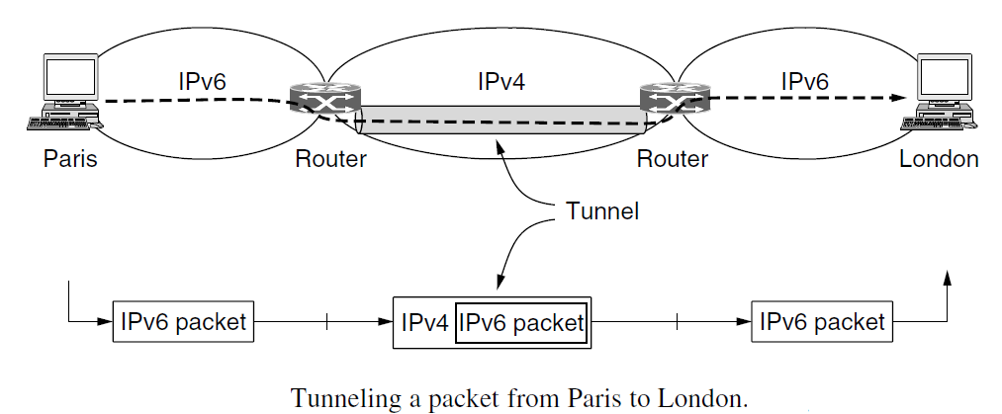
Tunneling
Tunneling
Source and destination hosts are on the same type of network, but there is a different network in between

Slide 89
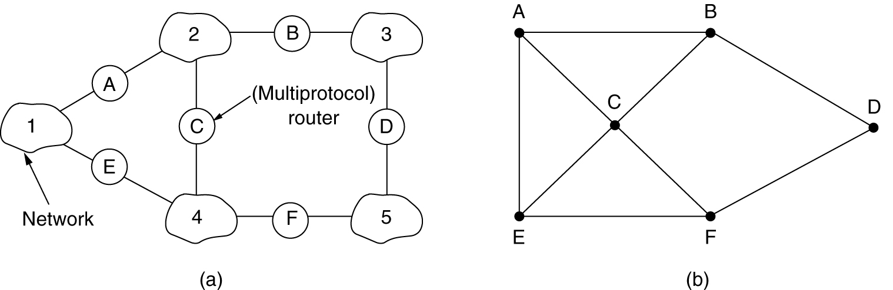
Internetwork Routing
(a)An internetwork. (b) A graph of the internetwork.
Interior gateway protocol (AS: Autonomous System)
Exterior gateway protocol

Slide 90
MTU: Maximum Transmission Unit
Hardware (e.g., the size of an Ethernet frame)
Operating system (e.g., all buffers are 512 bytes).
Protocols (e.g., the number of bits in the packet length field)
Compliance with some (inter)national standard.
Desire to reduce error-induced retransmissions to some level
Desire to prevent one packet from occupying the channel too long

Slide 91
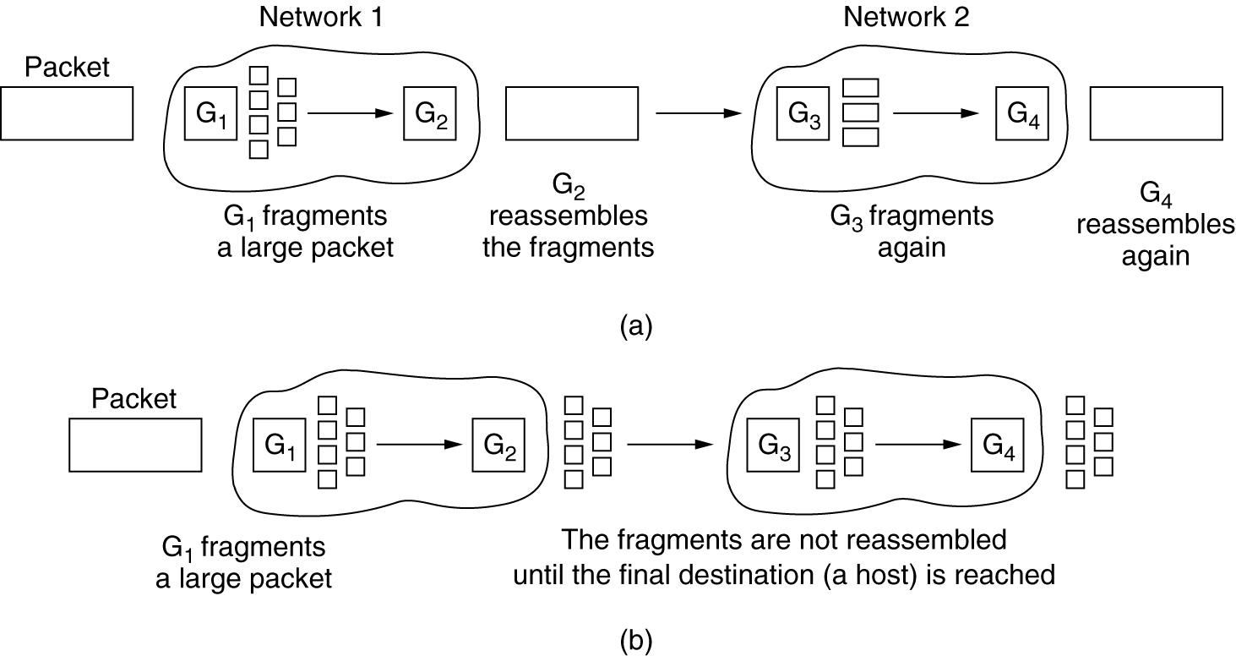
Fragmentation
(a) Transparent fragmentation. (b) Nontransparent fragmentation.
(a) Recombination occurs at the exit gateway (ATM)
(b) Recombination occurs only at the destination host (IP)

Slide 92
Transparent & Nontransparent Fragmentation
Transparent fragmentation
Exit gateway must know when it has received all pieces
All packets must exit via the same gateway.
Overhead (reassemble and then re-fragment)
Nontransparent fragmentation
Recombination occurs only at the destination host, it requires every host to be able to do reassembly，it requires routers to do less work
When a large packet is fragmented, the total overhead increases because each fragment must have a header，a whole packet is lost if any of its fragments are lost, and fragmentation is more of a burden for hosts

Slide 93
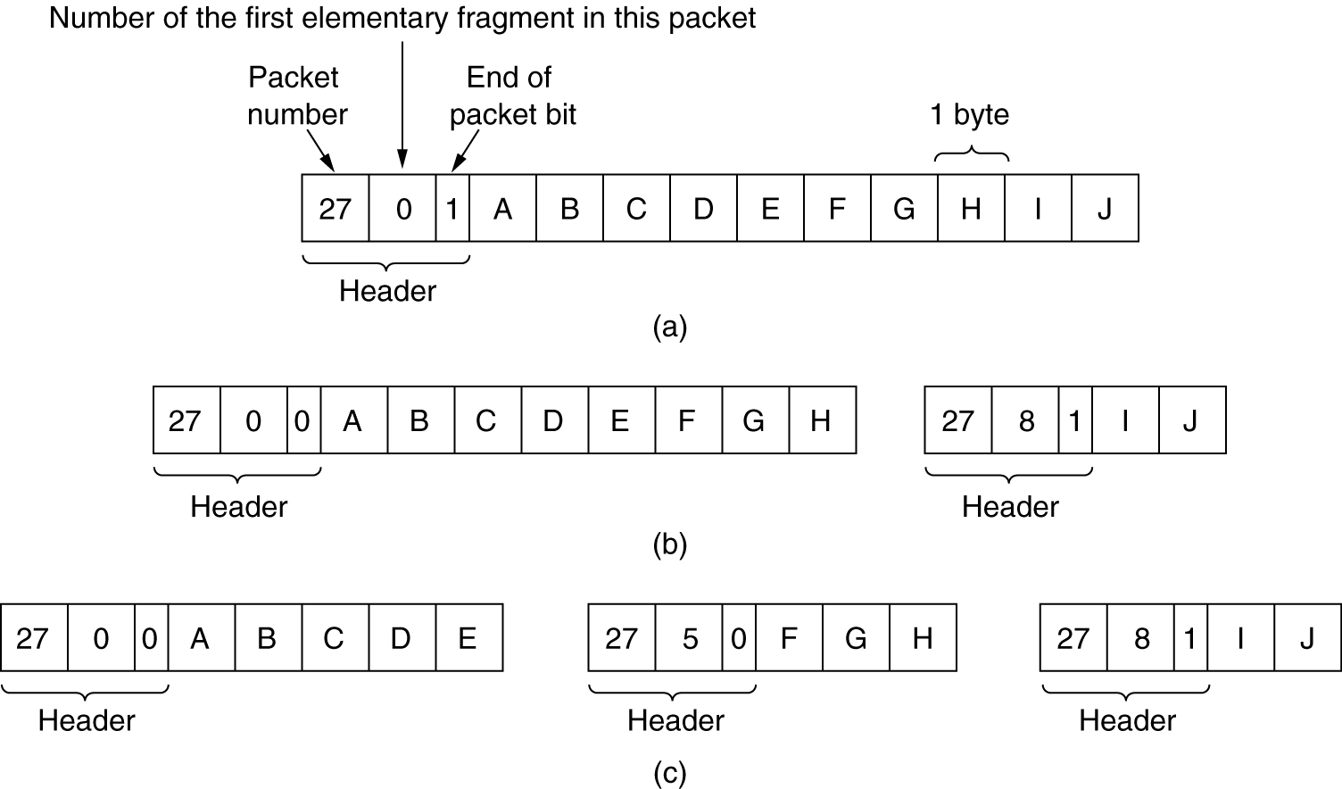
Numbering the Fragments (2)
Fragmentation when the elementary data size is 1 byte.
(a) Original packet, containing 10 data bytes.
(b) Fragments after passing through a network with maximum packet size of 8 payload bytes plus header.
(c) Fragments after passing through a size 5 gateway

Slide 94
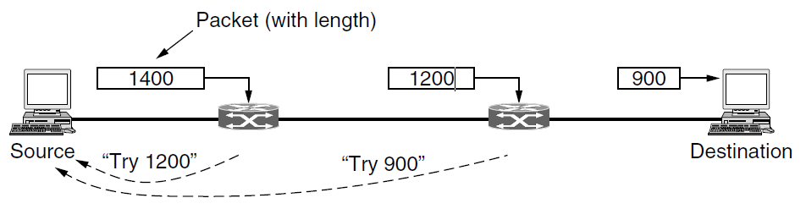
Solution of Getting Rid of Fragmentation
Path MTU discovery (Used in the modern Internet)
Source: IP packet is sent with its header bits set to indicate that no fragmentation is allowed
If a router receives a packet that is too large, it generates an error packet, returns it to source, and drops the packet
When the source receives the error packet, it uses the information inside to refragment the packet into pieces that are small enough
If a router further down the path has an even smaller MTU, the process is repeated.

Slide 95
5.6 The Network Layer in the Internet

Slide 96

The Top 10 Principles (RFC1958 Clark)
Make sure it works
Do not finalize the design or standard until multiple prototypes have successfully communicated with each other
Keep it simple
If a feature is not absolutely essential, leave it out, especially if the same effect can be achieved by combining other features
Make clear choices
If there are several ways of doing the same thing, choose one
Exploit modularity
Expect heterogeneity
Avoid static options and parameters
If parameters are unavoidable (e.g., maximum packet size), it is best to have the sender and receiver negotiate a value than defining fixed choices
Look for a good design; it need not be perfect
Be strict when sending and tolerant when receiving
Think about scalability
Consider performance and cost

Slide 97
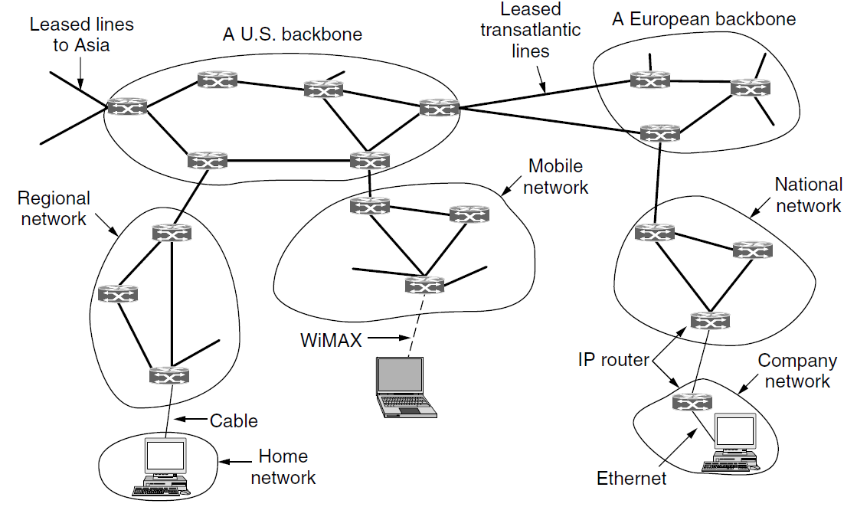

The Internet's Network Layer
Vinton Cerf, Robert Kahn 1974, Turing Award 2004
The Internet: a Collection of Subnetworks (Autonomous Systems) that are interconnected
Its job is to provide a best-efforts way to transport datagrams from source to destination

Slide 98
The IP Version 4 Protocol

Slide 99
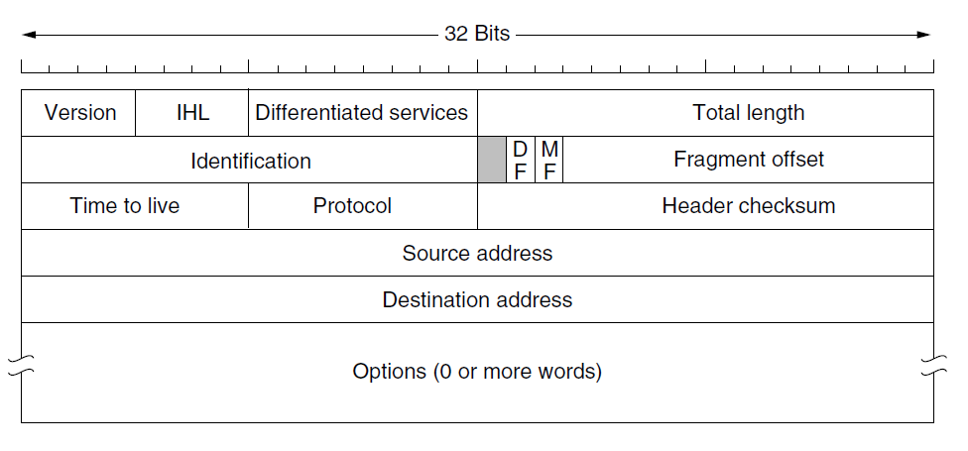
The IPv4 Header

Slide 100
The IPv4 Header (1)
Version (4 bits)
IHL(4 bits)
How long the header is, in 32-bit words, Val:5~15, 20~60 bytes
The Differentiated services field
Originally, it was called the Type of service field （TOS）
a 3-bit Precedence field: (Priority 0~7)
3 flags: Delay, Throughput, Reliability
Now, the top 6 bits are used to mark the packet with its service class the bottom 2 bits are used to carry explicit congestion notification (ECN) information
Total Length(16 bits)
Includes both header and data, in bytes
The maximum length is 65,535 bytes
45 00 00 30

Slide 101
The IPv4 Header (2)
Identification (16 bits)
Allow the destination host to determine which datagram a newly arrived fragment belongs to
All the fragments of a datagram contain the same Identification value
DF (1 bit)
Don't Fragment. It is an order to the routers not to fragment the datagram (Originally, it was intended to support hosts incapable of putting the pieces back together again. Now it is used as part of the process to discover the path MTU)
MF (1 bit)
More Fragments
Fragment offset (13 bits)
Tell where in the current datagram this fragment belongs, in 8 bytes (0~8191)
82 fc 40 00

Slide 102
The IPv4 Header (3)
TTL: Time to live (8 bits)
A counter used to limit packet lifetimes. It is supposed to count time in seconds
It must be decremented on each hop
When it hits zero, the packet is discarded and a warning packet is sent back to the source host
Protocol field (8 bits)
Which transport process to give it to (TCP/UDP,…)
1-ICMP, 6-TCP, 17-UDP,89-OSPF,
50-AH,51-ESP,132-SCTP,...
The Header checksum (16 bits)
Verifies the header only
Must be recomputed at each hop
80 06 f5 a5
Source & Destination address(32+32 bits)
80 a8 b1 99
3b 40 6e d5

Slide 103
Example
45 00 00 30
82 fc 40 00
80 06 f5 a5
80 a8 b1 99
3b 40 6e d5
06 64 31 ba 22 68 b9 90 00 00 00 00 70 02 ff ff ec e2 00 00
Notes:
128.168.177.153________59.64.110.213________

Slide 104
Example2
45 00 00 30
00 00 40 00
40 06 b8 a2
3b 40 6e d5
80 a8 b1 99
31 ba 06 64 5b 9f f7 1c 22 68 b9 91 70 12 20 00 83 45 00 00

Slide 105
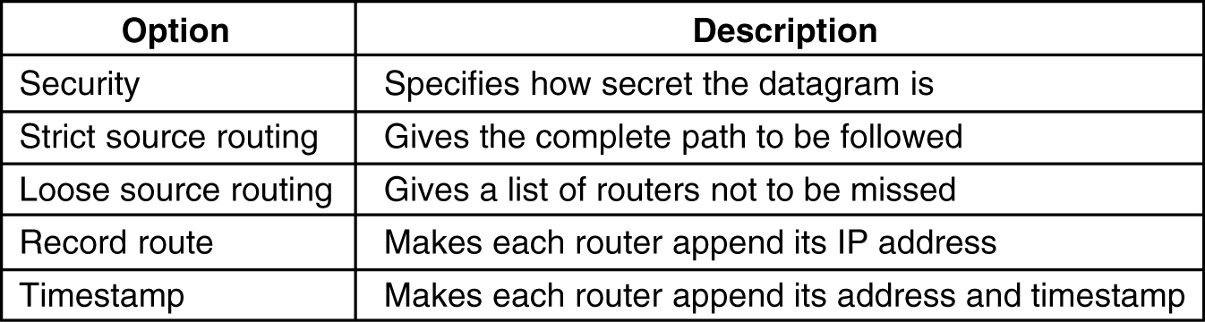
Some of the IP options
Security option
Strict source routing option
Gives the complete path from source to destination as a sequence of IP addresses
Loose source routing option
Requires the packet to traverse the list of routers specified, and in the order specified, but it is allowed to pass through other routers on the way
Record route option
Tells the routers along the path to append their IP address to the option field
The Timestamp option
Like the Record route option, except that in addition to recording its 32-bit IP address, each router also records a 32-bit timestamp

Slide 106
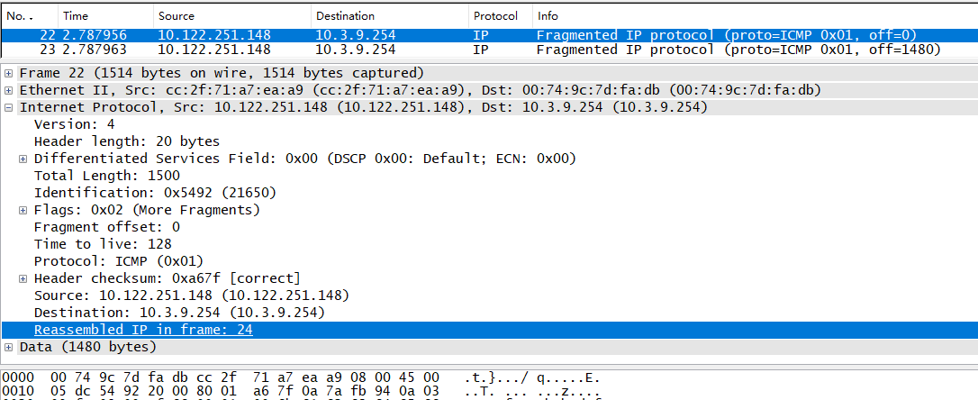
Example3

Slide 107
IP Addresses

Slide 108
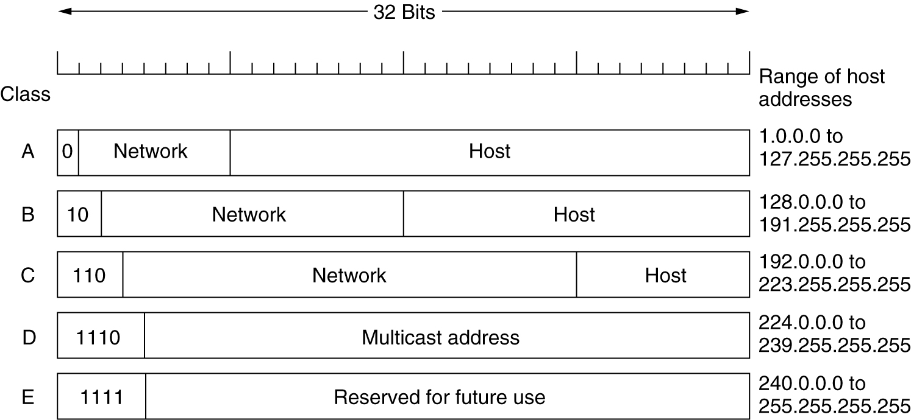
Class A, B, C, and D formats
ICANN (Internet Corporation for Assigned Names and Numbers)

Slide 109
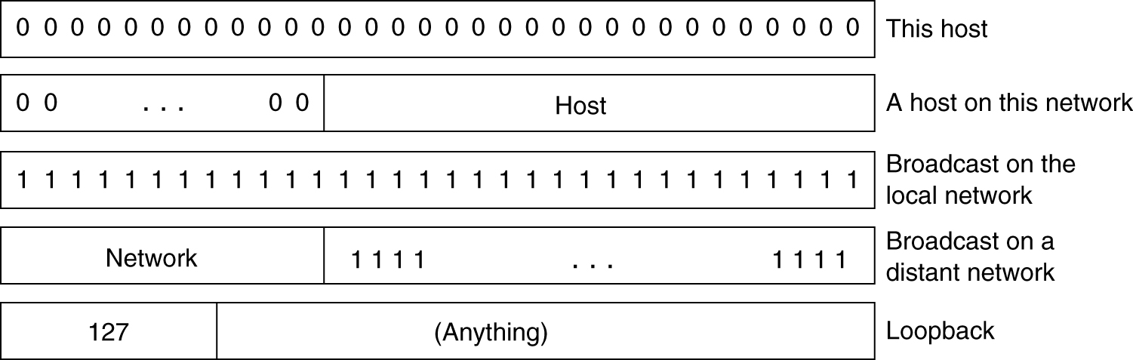
Special IP addresses

Slide 110
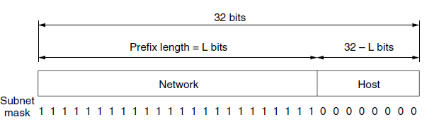
Prefixes
IP addresses are hierarchical
Each 32-bit address is comprised of a variable-length network portion and a host portion
The network portion has the same value for all hosts on a single network, a network corresponds to a contiguous block of IP address space (IP address block)
Routers forward packets based on only the network portion of the address
128.208.0.0/24 (prefix length)
128.208.0.0/255.255.255.0 (netmask)

Slide 111
Netmask and Prefix
/1 /2 /3 /4 /5 /6 /7 /8
192 224 240 248 252 254 255
/19 255.255.224.0

Slide 112
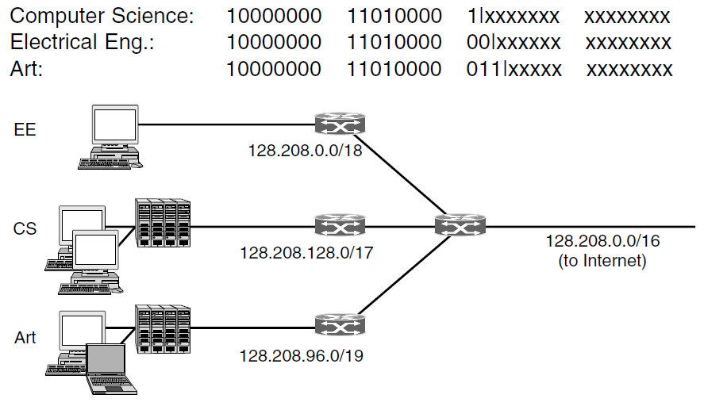
Subnets
Outside the network, the subnetting is not visible

Slide 113
Subnet
将IP地址空间192.168.1.0/24按网络号递增顺序分配给2个局域网LAN1～LAN2
子网 | 分配地址数 | 网络地址 | 子网掩码
LAN1 | 95
LAN2 | 76

Slide 114
Subnet
将IP地址空间192.168.1.0/24按网络号递增顺序分配给3个局域网LAN1～LAN3
子网 | 分配地址数 | 网络地址 | 子网掩码
LAN1 | 95
LAN2 | 56
LAN3 | 60

Slide 115
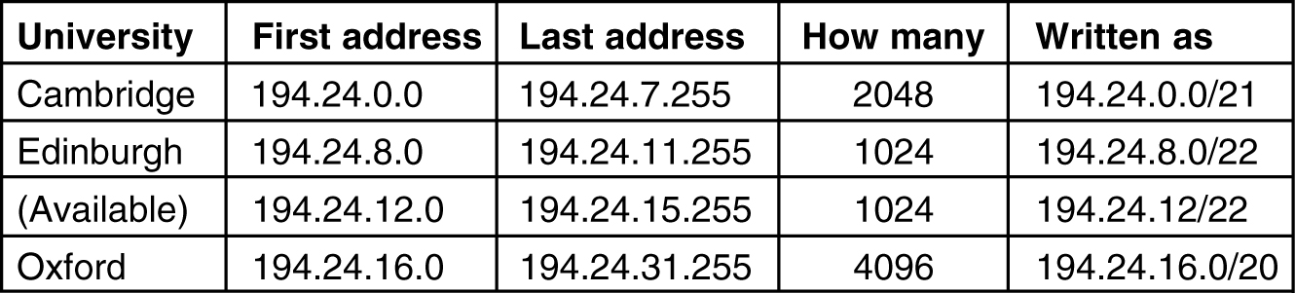
CIDR—Classless InterDomain Routing
Route aggregation
To reduce routing table sizes, combine multiple small prefixes into a single larger prefix
C 11000010 00011000 00000xxx xxxxxxxx
E 11000010 00011000 000010xx xxxxxxxx
(A) 11000010 00011000 000011xx xxxxxxxx
O 11000010 00011000 0001xxxx xxxxxxxx
C 11111111 11111111 11111000 00000000 255.255.248.0
E 11111111 11111111 11111100 00000000 255.255.252.0
(A) 11111111 11111111 11111100 00000000 255.255.252.0
O 11111111 11111111 11110000 00000000 255.255.240.0

Slide 116
IP Address Assignments(Oxford subnet)
C 11000010 00011000 00000xxx xxxxxxxx (194.24.0.0-194.24.7.255)
E 11000010 00011000 000010xx xxxxxxxx (194.24.8.0-194.24.11.255)
A 11000010 00011000 000011xx xxxxxxxx (194.24.12.0-194.24.15.255)
O 11000010 00011000 00010xxx xxxxxxxx
O 11000010 00011000 000110xx xxxxxxxx
C 11000010 00011000 00000xxx xxxxxxxx (194.24.0.0-194.24.7.255)
E 11000010 00011000 000010xx xxxxxxxx (194.24.8.0-194.24.11.255)
A 11000010 00011000 000011xx xxxxxxxx (194.24.12.0-194.24.15.255)
O 11000010 00011000 0001xxxx xxxxxxxx (194.24.16.0-194.24.31.255)

Slide 117
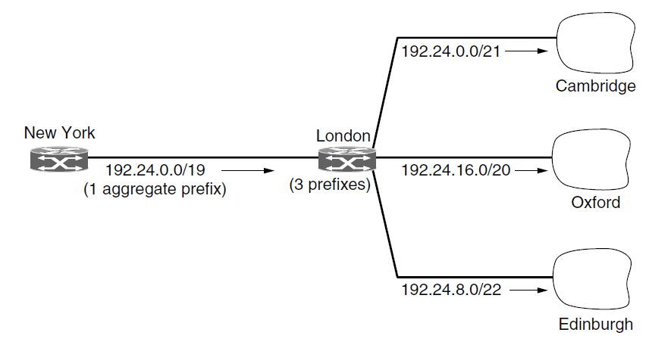
Aggregation of IP prefixes

Slide 118
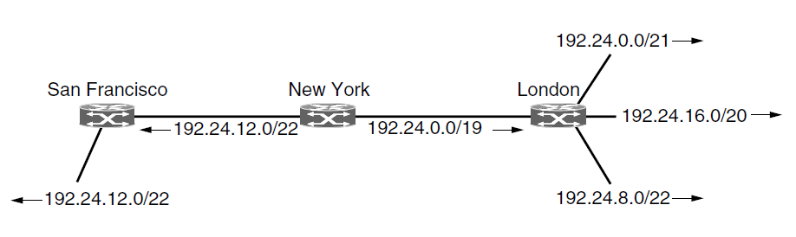
Longest matching prefix routing
Notes:
Route-server.ip.att.net

Slide 119
Routing Table
Routing table
An array of (IP address, netmask, outgoing line, Next hop)
Scan the routing table
Mask the destination address and comparing it to the table entry looking for a match
It is possible that multiple entries (with different netmask lengths) match, in which case the longest mask is used
If there is a match for a /20 mask and a /24 mask, the /24 entry is used.
Implementation
Complex algorithms have been devised to speed up the address matching process
commercial routers use custom VLSI chips with these algorithms embedded in hardware

Slide 120
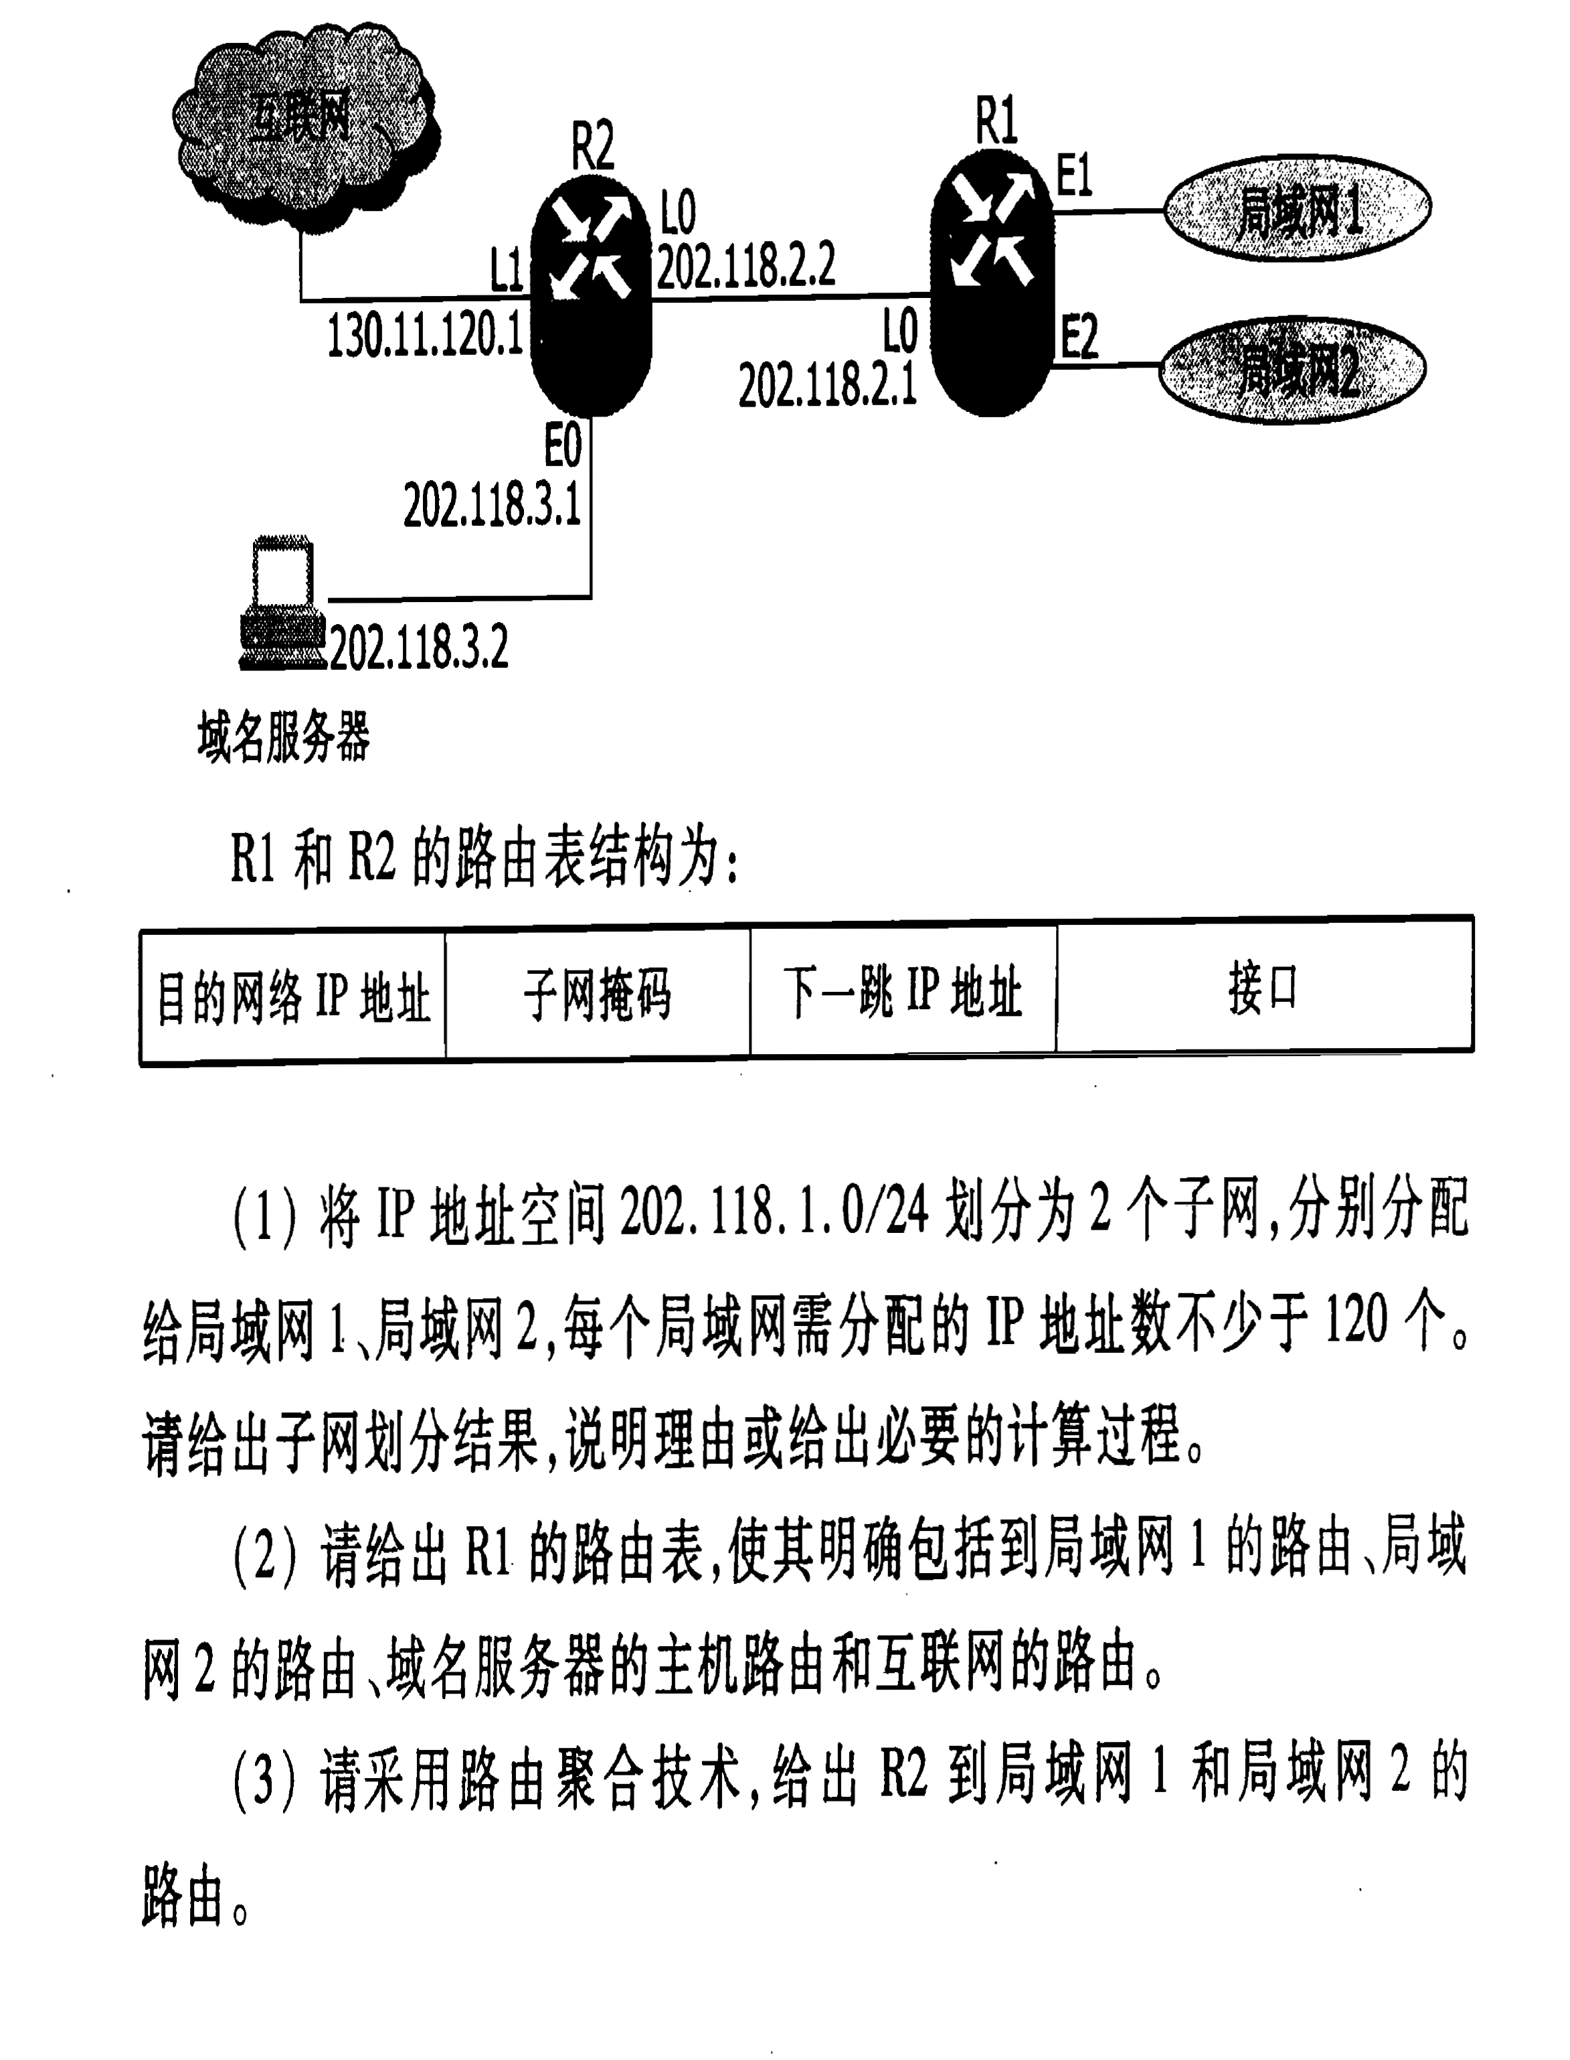

Slide 121
Routing
地址/掩码 | 下一跳
135.46.56.0/22 | 接口0
135.46.60.0/22 | 接口1
192.53.40.0/23 | 路由器1
默认(0.0.0.0/0) | 路由器2
(a) 135.46.63.10
(b) 135.46.57.14
(c) 135.46.52.2
(d) 192.53.40.7
(e) 192.53.56.7

Slide 122
Routing Table

Slide 123
Routing Table

Slide 124
NAT

Slide 125
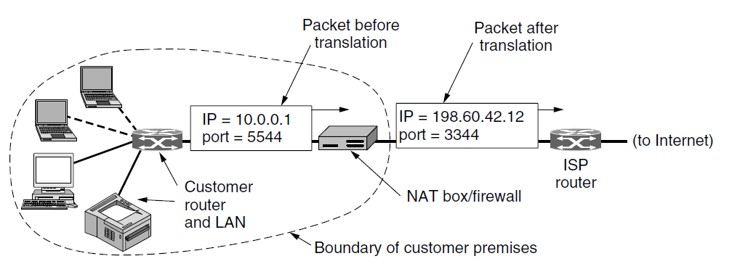
NAT (Network Address Translation)
Outgoing packet
10.x.y.z source address and TCP Source port are replaced
Both the IP and TCP checksums are recomputed
Incoming packet
Destination port =>internal IP address and original TCP Source port, Recompute IP and TCP checksums
Deliver the packet using the 10.x.y.z address

Slide 126
Private Network Address
The three reserved ranges
10.0.0.0 – 10.255.255.255/8 (Prefix 1.0B)
00001010.xxxxxxxx.xxxxxxxx.xxxxxxxx
(16,777,216 hosts)
172.16.0.0 – 172.31.255.255/12 (Prefix 1.5B)
10101100.0001xxxx.xxxxxxxx.xxxxxxxx
(1,048,576 hosts)
192.168.0.0 – 192.168.255.255/16 (Prefix 2.0B)
11000000.10101000.xxxxxxxx.xxxxxxxx
(65,536 hosts)
10.0.0.0/8, 172.16.0.0/12, 192.168.0.0/16

Slide 127
动态NAT表项
A：发送TCP报 10.0.0.1:3723->18.7.22.83:80
R：路由器动态创建NAT表项:
(Local)10.0.0.1:3723—(Global)123.116.156.133:33120—(Peer)18.7.22.83:80
改TCP报为123.116.156.133:33120->18.7.22.83:80
S：服务器S回数据18.7.22.83:80->123.116.156.133:33120
R：查NAT表：改TCP报为为18.7.22.83:80->10.0.0.1:3723
A：收到数据包18.7.22.83:80->10.0.0.1:3723
（连接过程中使用该NAT表项，当连接关闭时或长久未用的NAT表项，删除）
OUT: (SRC)10.0.0.1:3723—(DST)18.7.22.83:80=>(SRC)123.116.156.133:33120
IN: (SRC)18.7.22.83:80—(DST)123.116.156.133:33120=>(DST)10.0.0.1:3723
Notes:
TABLE IN NAT ROUTER
-----------------------------------------------------
(Local) (Global) （Peer）
10.0.0.1:9900—123.116.156.133:1—18.7.22.83:80
10.0.0.2:9900—123.116.156.133:2—18.7.22.83:80
10.0.0.3:9900—123.116.156.133:3—18.7.22.83:80
…
10.0.255.255:9900—123.116.156.133:65535—18.7.22.83:80
10.1.0.1:9900—123.116.156.133:1—118.7.22.83:80
10.1.0.2:9900—123.116.156.133:2—118.7.22.83:80
10.1.0.3:9900—123.116.156.133:3—118.7.22.83:80
…
10.1.255.255:9900—123.116.156.133:65535—118.7.22.83:80
-------------------------------------------------------------
Item Example:
10.1.255.255:9900—123.116.156.133:65535—118.7.22.83:80
IP Packets:
PC->ROUTER: 10.1.255.255:9900->118.7.22.83:80
ROUTER->SERVER: 123.116.156.133:65535->118.7.22.83:80
SERVER->ROUTER: 118.7.22.83:80->123.116.156.133:65535
ROUTER->PC: 118.7.22.83:80->10.1.255.255:9900

Slide 128
静态NAT表项
R：设10.0.0.7为Web服务器: 建立静态NAT表
(Local)10.0.0.7:8080—(Global)123.116.156.133:80 —(Peer)*:*
C：因特网上的客户端C发送TCP数据包：
17.1.1.10:3598->123.116.156.133:80
R：查 NAT表，改为17.1.1.10:3598->10.0.0.7:8080
W：Web服务器回数据10.0.0.7:8080->17.1.1.10:3598
R：查 NAT表，改为123.116.156.133:80->17.1.1.10:3598
C：收到返回TCP数据报123.116.156.133:80->17.1.1.10:3598

Slide 129
Some of the Objections to NAT
NAT violates the architectural model of IP (IP地址不唯一标识一台计算机)
NAT changes the Internet from a connectionless network to a kind of connection-oriented network
NAT breaks the end-to-end connectivity model of the Internet (外网计算机无法主动发起向内网计算机的访问)
NAT violates the most fundamental rule of protocol layering: layer k may not make any assumptions about what layer k + 1 has put into the payload field
Processes on the Internet are not required to use TCP or UDP(无法支持非TCP/UDP)
Some applications insert IP addresses in the body of the data
FTP works this way

Slide 130
IPv6

Slide 131
IPv6: Major Goals
Address space
Reduce the size of the routing tables
Simplify the protocol, to allow routers to process packets faster
Security
Pay more attention to type of service, particularly for real-time data
Multicasting
Make it possible for a host to roam without changing its address
Allow the protocol to evolve in the future
Permit the old and new protocols to coexist for years

Slide 132

The Main IPv6 Header

Slide 133
The Main IPv6 Header
Address space
128 bits, Total 3x10³⁸
7x10²³ IP addresses per square meter on the Earth
IPv6 header has a fixed length
The IHL field is gone
The Protocol field was taken out
Flow label
Each flow is designated by the source address, destination address, and flow number
Fields relating to fragmentation were removed
When a host sends a packet that is too large, the router sends back an error message
This message tells the host to break up all future packets to that destination
Checksum field is gone

Slide 134

The IPv6 Extension Headers

Slide 135
IPv6 Address Notation
8 groups of 4 hexadecimal digits with colons between the groups
8000:0000:0000:0000:0123:4567:89AB:CDEF
3 optimizations
Leading zeros within a group can be omitted
8000:0:0:0:123:4567:89AB:CDEF
One or more groups of 16 zero bits can be replaced by a pair of colons
8000::123:4567:89AB:CDEF
IPv4 addresses can be written as a pair of colons and an old dotted decimal number
::192.31.20.46

Slide 136
Internet Control Protocols

Slide 137
ICMP (Internet Control Message Protocol)
ICMP message is encapsulated in an IP packet
DESTINATION UNREACHABLE
a router cannot locate the destination
a packet with the DF bit cannot be delivered because a ''small-packet'' network stands in the way
TIME EXCEEDED
a packet is dropped because its TTL counter has reached zero
SOURCE QUENCH
Choke packet：When a host received this message, it was expected to slow down
REDIRECT
a router notices that a packet seems to be routed wrong
It is used by the router to tell the sending host about the probable error
ECHO and ECHO REPLY
TIMESTAMP REQUEST and TIMESTAMP REPLY
The ROUTER ADVERTISEMENT and ROUTER SOLICITATION
used to let hosts find nearby routers

Slide 138
ICMP报文的格式
0
8
16
31
前 4 个字节
都是一样的
类型
代码
检验和
（这 4 个字节取决于 ICMP 报文的类型）
ICMP 的数据部分（长度取决于类型）
ICMP 报文
首 部
数据部分
IP 数据报
ICMP报文分两类，即ICMP差错报告报文和ICMP询问报文
ICMP 报文的前4个字节是统一的格式，共有三个字段：即类型、代码和检验和。接着的4个字节的内容与ICMP的类型有关

Slide 139
ICMP差错报告报文的数据字段的内容
IP 数据报的数据字段
收到的 IP 数据报
IP 数据报
首部
8
字节
ICMP 的
前 8 字节
IP 数据报
首部
8
字节
ICMP 差错报告报文
首部
ICMP 差错报告报文
装入 ICMP 报文的 IP 数据报
IP 数据报

Slide 140
ICMP的几种应用
traceroute
利用TTL=0回送ICMP报文测路径，发TTL=1, =2, =3, ..., 的报文,回送ICMP报文的节点地址就是路径地址
主机分片
以太网上主机TCP发送DF=1的1500字节IP报文经ADSL路由器MTU=1492,回ICMP报文报告MTU=1492,TCP重传并且后续发送报片长度均为1492
目的不可达
主机TCP建连接，向远端网络未开机计算机发送IP报文，远端网络的路由器回ICMP报文报告主机不可达
路由重定向
路由器收到IP报，转发，并用ICMP通告更好的转发路由器地址

Slide 141
Windows tracert
d:\>tracert -d 202.108.33.89
Tracing route to 202.108.33.89 over a maximum of 30 hops
1 11 ms 3 ms 5 ms 118.207.192.1
2 5 ms 5 ms 2 ms 118.207.192.1
3 10 ms 6 ms 7 ms 124.205.97.48
4 4 ms 6 ms 2 ms 218.241.165.5
5 4 ms 3 ms 3 ms 218.241.165.9
6 5 ms 6 ms 5 ms 202.99.1.146
7 5 ms 12 ms 22 ms 124.207.222.26
8 20 ms 18 ms 31 ms 61.51.26.165
9 27 ms 18 ms 17 ms 211.154.208.189
10 22 ms 19 ms 17 ms 124.65.60.185
11 22 ms 27 ms 20 ms 61.148.152.5
12 16 ms 19 ms 27 ms 202.106.229.58
13 81 ms 18 ms 19 ms 210.74.178.198
14 20 ms 18 ms 23 ms 202.108.33.89
Trace complete

Slide 142
ARP,DHCP

Slide 143

路由表，直接交付与间接交付

Slide 144
ARP: Address Resolution Protocol
How do IP addresses get mapped onto data link layer addresses, such as Ethernet?
A configuration file in the system that maps IP addresses onto Ethernet addresses
A better solution is to output a broadcast packet onto the Ethernet asking: Who owns IP address 192.31.65.5?

Slide 145
A Broadcasts
ARP REQUEST
我是 192.31.65.16，硬件地址是 00-00-C0-15-AD-18
我想知道主机 192.31.65.5的硬件地址
ARP 请求
ARP 请求
ARP 请求
ARP 请求
192.31.65.16
192.31.65.5
X
A
Y
B
Z
00-00-C0-15-AD-18
B unicasts to A
ARP RESPONSE
我是 192.31.65.5
硬件地址是 00-06-2B-00-EE-0A
ARP 响应
192.31.65.16
192.31.65.5
X
A
Y
B
Z
00-00-C0-15-AD-18
00-06-2B-00-EE-0A

Slide 146
ARP: Optimizations
Source host: ARP cache
Entries in the ARP cache should time out after a few minutes
Destination host:
Records sender's (Ethernet address, IP address) pairs into cache
Other machines on the same Ethernet:
Can enter the IP/MAC mapping in ARP REQUEST into their ARP caches
Gratuitous ARP: host broadcasts its IP/MAC when it boots, an ARP looking for its own IP address
Side effect of the broadcast: make an entry in everyone's ARP cache
If a response does (unexpectedly) arrive, two machines have been assigned the same IP address

Slide 147
Proxy ARP
Host A send an IP datagram to Host B

Slide 148

DHCP
DHCP (Dynamic Host Configuration Protocol)
Allows both manual IP address assignment and automatic assignment (IP address, netmask, DNS server address, default gateway, file server, ......)
In most systems, it has largely replaced RARP and BOOTP
DHCP packet : DISCOVER/OFFER/REQUEST/ACK
RFC 951,1084,1123,1533,1534,1497,1541
Leasing & renewal

Slide 149
DHCP Client-Server Scenario
DHCP server: 223.1.2.5
Arriving
client
DHCP discover
src : 0.0.0.0, 68
dest.: 255.255.255.255,67
ipaddr: 0.0.0.0
transaction ID: 654
mac: 00-23-56-1e-dc-14
DHCP offer
src: 223.1.2.5, 67
dest: 255.255.255.255, 68
ipaddr: 223.1.2.4
transaction ID: 654
mac: 00-23-56-1e-dc-14
Lifetime: 3600 secs
DHCP request
src: 0.0.0.0, 68
dest:: 255.255.255.255, 67
ipaddr: 223.1.2.4
transaction ID: 655
mac: 00-23-56-1e-dc-14
Lifetime: 3600 secs
time
DHCP ACK
src: 223.1.2.5, 67
dest: 255.255.255.255, 68
ipaddr: 223.1.2.4
transaction ID: 655
mac: 00-23-56-1e-dc-14
Lifetime: 3600 secs
UDP is Used

Slide 150

DHCP Relay Agent

Slide 151
OSPF (Open Shortest Path First)

Slide 152
Routing Protocol
Interior Gateway Protocol
RIP
EIGRP (Security)
OSPF (Security)
IS-IS (Security)
Exterior gateway protocol
BGP-4

Slide 153
Example
Interior router
BGP router
AS-1
AS-3
AS-2

Slide 154
OSPF: Requirements
Open (RFC 2328)
Dynamic algorithm: adapt to changes in the topology automatically and quickly
Support routing based on type of service
Load balancing, splitting the load over multiple lines
Hierarchical systems
Security

Slide 155
3 Kinds of Connections and Networks
Point-to-point lines between exactly two routers
Multi-access networks (How to find neighbors)
Broadcasting (e.g., most LANs)
Without broadcasting (e.g., most packet-switched WANs) NBMA
About Multi-access networks
Designated router
Neighboring routers that are not adjacent do not exchange information with each other
The arcs from the network node to the routers have weight 0

Slide 156

Link State Information

Slide 157
OSPF Area
Divide AS into numbered ‘areas’
Every AS has only one backbone area, called area 0, all areas are connected to the backbone
Within an area, each router has the same link state database and runs the same shortest path algorithm
A router that connects to two areas needs the databases for both areas and must run the shortest path algorithm for each one separately

Slide 158

Areas

Slide 159
OSPF Routers
Internal routers
Outside an area, its destinations are visible but not its topology
Area border Router (part of the backbone)
Summarize the destinations in one area and inject this summary into the other. This summary includes cost info but no topology info (reduces traffic and simplifies the shortest-path computations)
If there is only 1 router out of an area, routes to hosts out of the area always by the router (stub area)
AS boundary router
Injects routes to external destinations on other ASes into the area, the external routes appear as destinations that can be reached via the AS boundary router
An external route can be injected at one or more AS boundary routers

Slide 160

5 Types of OSPF Messages
OSPF messages are sent as raw IP packets (Proto 89)

Slide 161
OSPF Messages
HELLO报文
状态：Down -> Init -> 2-Way，选举DR和BDR
数据库描述（DD）报文
两路由器初始化连接时交换链路状态数据库描述报文(仅用于描述而非实际传送链路-状态数据库内容)
链路-状态请求报文
收齐DD报文之后，用这种报文请求相邻路由器链路状态数据库中的部分必要的数据，以达到拓扑结构信息同步
链路-状态更新报文
把链路状态信息发给相邻节点
邻接建立期间将用此报文回应“链路状态请求”报文的请求
邻接关系维持期间，洪泛法散播链路状态信息也用这个报文
链路-状态应答报文
可靠地分发LS信息，该报文是对“链路-状态更新报文”的ACK

Slide 162
BGP (Border Gateway Protocol)

Slide 163
BGP: Goals
Goals of an interior gateway protocol and an exterior gateway protocol
All an interior gateway protocol has to do is move packets as efficiently as possible from the source to the destination
IGP着重发现和计算路由，EGP控制路由的传播和选择最佳路由
Routing policies
Typical policies involve political, security, or economic considerations
Policies are typically manually configured into each BGP router (or included using some kind of script)
They are not part of the protocol itself
From the point of view of a BGP router, the world consists of ASes and the lines connecting them

Slide 164

Transit and Peering
Transit Service
Peering
two ASes send routing advertisements to each other for the addresses that reside in their networks

Slide 165

Propagation of BGP Route Advertisements
TCP connection between pairs of BGP routers
Path vector Protocol
(Prefix, AS path, Next hop)

Slide 166
How BGP Routers Choose Route
Detect and break routing loop
Routes via peered networks are chosen in preference to routes via transit providers
Shorter AS paths are better
Prefer the route that has the lowest cost within AS
known as early exit or hot-potato routing
It has the curious side effect of tending to make routes asymmetric

Slide 167

MODEM

